Slide 1
fletchergroup.org
HRSA Rural Center of Excellence
on
Recovery Housing
ERNIE FLETCHER, MD
Fletcher Group Co-Founder

Slide 2
KENTUCKY ORIGINS
Our recovery expertise began in 2004 when Don Ball and Governor Ernie Fletcher launched Recovery Kentucky—18 recovery residences that helped thousands of people rebuild their lives while saving millions in taxpayer dollars.
Our History

Slide 4
Dedicated to expanding access to quality Evidence-Based Recovery Housing for all populations, particularly the most vulnerable.
ONE VOICE
We work hand-in-hand with NARR and other partners to ensure a nationally unified voice for Recovery Residences supporting people in recovery.
Notes:
Breaking down silos and working to have one voice to bring the best practices and most experienced experts together to solve the challenges
Time: .25

Slide 5
Our Focus
EVIDENCE-BASED TA
Field-proven tools and expertise to maximize your effectiveness.
NATIONAL REACH
We're working in rural communities in Idaho, Montana, Washington, Oregon, Kentucky, Georgia, West Virginia, Ohio, and other rural communities as requested.
HOUSING FOCUS
With a particular emphasis on the homeless and those with SUDs involved in the criminal justice system.

Slide 6
PARTNERS

Slide 7
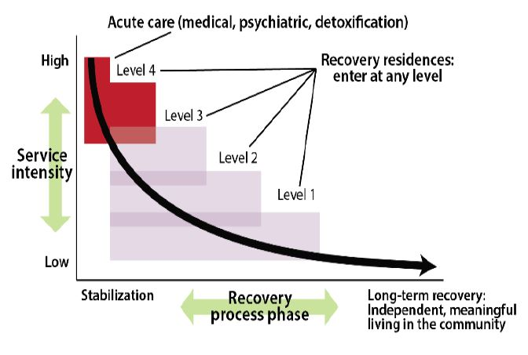
NARR Levels of Support
Recovery Residences In The Continuum Of Recovery
Notes:
First, there is not a lot of research on evidence-based practices in RH and that is one of major goals that aligns with this core activity
Secondly, as we have already begun to realize, there is not a lot of help especially in rural areas in this “cottage industry” and our efforts include “boots on the ground” and working with local partners to bring educational resource defining what works and what doesn’t
Thirdly, there is little a large need for help to RH providers across the spectrum of evidence based practices, but even more basic, zoning, NIMBY, financing, bundling of creative resources. That is what our activities will be focused on.
Time: .25
To bolster this a large component of data collection and outcomes measurement will help us develop the industry standards of best practices.

Slide 8
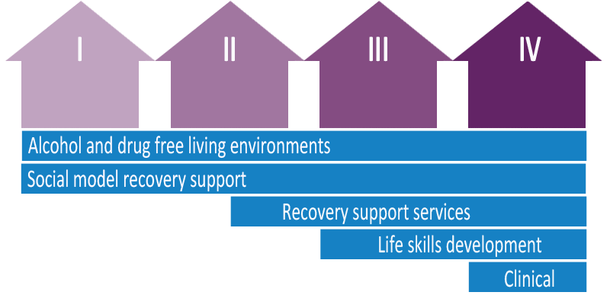
Notes:
First, there is not a lot of research on evidence-based practices in RH and that is one of major goals that aligns with this core activity
Secondly, as we have already begun to realize, there is not a lot of help especially in rural areas in this “cottage industry” and our efforts include “boots on the ground” and working with local partners to bring educational resource defining what works and what doesn’t
Thirdly, there is little a large need for help to RH providers across the spectrum of evidence based practices, but even more basic, zoning, NIMBY, financing, bundling of creative resources. That is what our activities will be focused on.
To bolster this a large component of data collection and outcomes measurement will help us develop the industry standards of best practices.
Time: .5

Slide 9
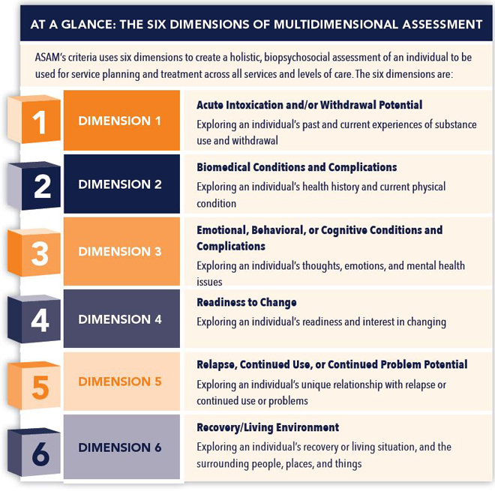
ASAM Criteria
Core Activities:
Science-based interventions
Dissemination of best practices in rural communities

Slide 10
Understanding Pathways to Recovery
Referral Sources
Case Management
Employment
Support
Peer Support
Criminal Justice
Treatment Providers
Counselors
Community Support Groups
Self-directed
Stable Housing
Life Skills
Development
Employment
Education
Support
Behavioral Health
Transportation
Housing
Social Support
Notes:
Time: .5

Slide 11
CHAOS
Recovery Housing is an unregulated industry prone to fraud and abuse.
The Challenge
CONFUSION
Desperate families spend thousands of dollars with no help to loved ones.
LACK OF RESOURCES
Rural communities lack the funds and resources to respond.

Slide 12
Unique Rural Challenges
101 Counties
In 8 States
HIGHER RATES
HIGHER COSTS
Kentucky
Ohio
West Virginia
Georgia
Montana
Idaho
Oregon
Washington
of SUD incidence, morbidity, overdose occurrence and mortality.
Long-distance travel to facilities adds significantly to already high costs.
FEWER RESOURCES
GREATER STIGMA
Doctors diagnosing SUDs are less likely to have the resources and training for follow-up care.
Smaller rural communities may experience less privacy and, as a result, more social stigma.

Slide 13
VULNERABLE
DISTRUST
More Native Americans meet the diagnostic criteria
for SUD than any other ethnic or minority group.
Of mainstream institutions exacerbated by treatment protocols that may be culturally insensitive.
Unique Cultural
Challenges
GEOGRAPHY
COMPLEXITY
Widely dispersed facilities and the technicalities of insurance can present additional problems.
Areas lacking social services and education are also more likely to interact with the criminal justice system.
Notes:
Our geography as you will see is across the nation. Why, to capture the cultural differences as part of the delivery of best practices that are tailored to where people live.
In our first meeting with Native Americans in Montana, the need for time and place for unique native American practices our important for the identification of who they are, and provide powerful tools to foster community and belonging.
Time: .5

Slide 14
FEDERAL FUNDING
We recently became one of three recipients to receive $6.6 million over the next three years.
HRSA Grant
RECOVERY HOUSING
Alone among the three recipients, our Rural Center Of Excellence is laser- focused on Recovery Housing.

Slide 15
NON-COMPETITIVE
Who gets the credit?
PARTNERING
SAMHSA’s BRSS-TACS
NIH HEALing Communities
State NARR Affiliates
HHS’s Findtreatment.gov
Collaboration
Integrating Silos
INTEGRATING WITH STAKEHOLDERS
Integrate with community efforts not rebuild
Notes:
There are a number of efforts that exist without collaboration. Our effort is to bring to gather these efforts, especially around RH to find synergies for the
Time: .3

Slide 16
OES
Surveillance
Baseline County Data Collection
Core Activity: 1) Science-based interventions
Notes:
OES gather information on RH in rural communities, very little data exist.
Time: ..5

Slide 17
KIPRC
Developing a portal and mobile app to collect data from RH and patients.
DATA
Outcomes
Core Activity: 1) Science-based interventions
Notes:
Tyler can present this and detail to work that KIPRC is doing to establish the portal for data and outcomes
Time: 1 min.

Slide 18
KIPRC
&
NARR
Education
Training
Developing an educational portal for access to educational models refletcting best practices in RH
Core Activities:
2) Dissemination of best practices in rural communities
3) Providing scientific and technical assistance
Notes:
Time: 1 min

Slide 19
KIPRC
NARR
SAFEProject
FindTreatment.gov
RH Directory
Integrate state and national data to create a national registry of RH for consumer access to quality and value.
Core Activities:
2) Dissemination of best practices in rural communities
3) Providing scientific and technical assistance
Notes:
Several efforts have started in different states to create registries. KIPRC has findhelpnowKY.org which provides a registry of treatment providers across the state. Admiral Sandyadn Mary Winnefeld, who lost a son to an opioid overdose founded SafeProject from their experience in not being able to find a quality, legitimate recovery housing. No registry exist to help those with addiction, or their families find quality RH among the sea of fraud and abuse or just misguided efforts.
Tyler can also comment of the work with findhepnowky.org
Time: 1 min

Slide 20
RH Directory
Consumer
State Affiliates
Ohio
Oregon
Oxford House
FindTreatment.gov
Notes:
Time: .5

Slide 21
“Boots
on
the Ground”
Helping “Face to Face”
Becoming part of the community
Understanding the cultural nuances
Working to bring down state and local silos
Notes:
We don’t just show the way, we step in and walk along the paths of those who need help and guidance. Many Centers of Excellence do a great job of providing information, but most don’t reach out to organize communities and offer to help.
Time: .5

Slide 22
Top Down
Bottom Up
Bring down silos,
Inform RH strategies
State effort and strategy
Local Community efforts
Integrate with existing efforts
All politics are local
Tip O’Neill, Speaker, House of US Representatives, 1977-1987
Notes:
Time: .5

Slide 23
We focus on vulnerable populations.
#1
THE HIGHEST INCREASE IN OVERDOSE
MORTALITY IS AMONG NATIVE AMERICANS
Source: Centers for Disease Control and Prevention Morbidity and Mortality Weekly Report, Dec. 21, 2018
(specifically drug- and opioid-involved overdose mortality)

Slide 24
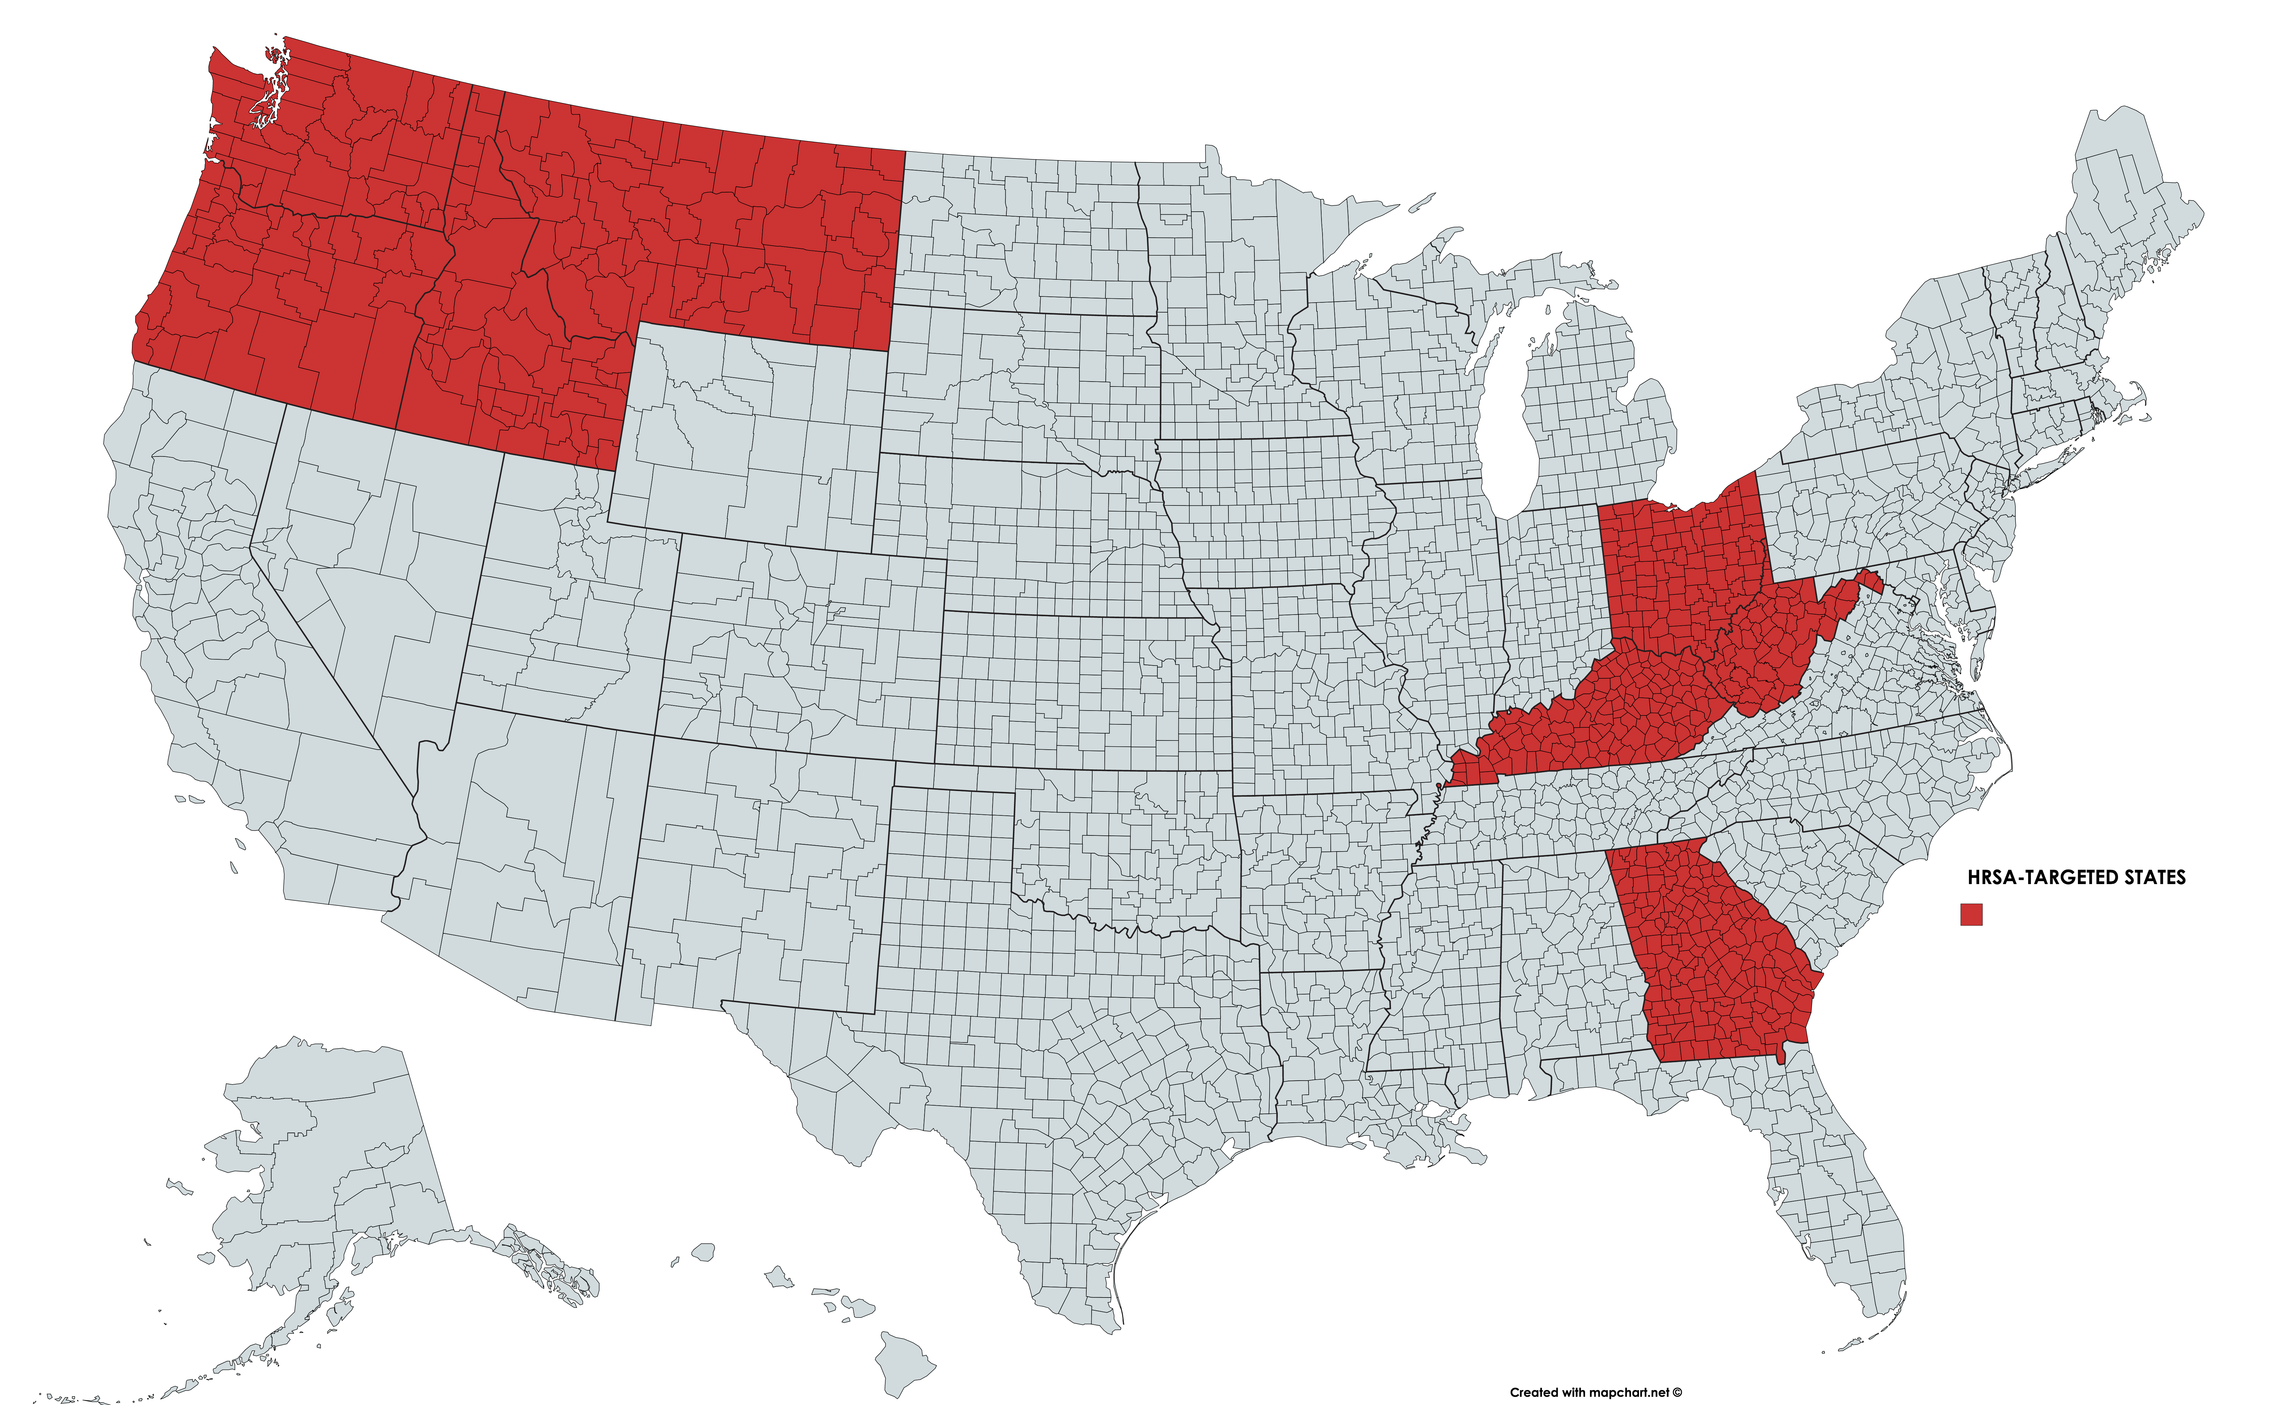
Currently Targeted States
Notes:
This slide shows the states specifically targeted in our HRSA grant. Why these states? Because over 100 counties in these states lead the nation In overdose deaths. While these states and counties are targeted by the HRSA, I should note that we are not limited to them. We are able and eager to team up with local stakeholders anywhere in the country.

Slide 25
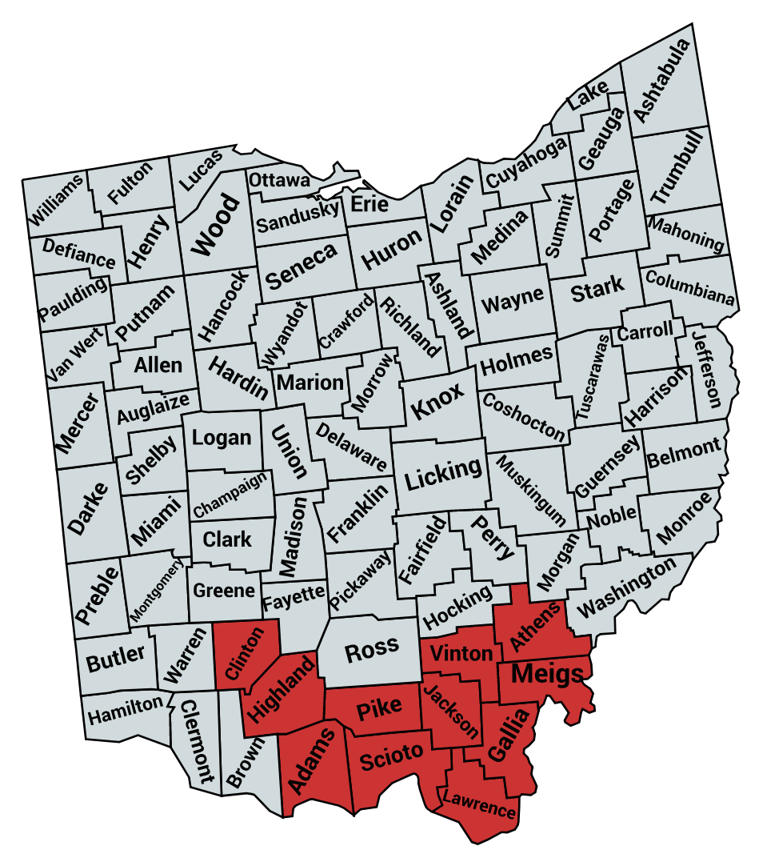
OHIO TARGET COUNTIES
Adams (27,724)
Athens (65,818)
Clinton (42,057)
Gallia (29,979)
Highland (43,058)
Jackson (32,384)
Lawrence (60,249)
Meigs (23,106)
Pike (28,067)
Scioto (75,502)
Vinton (13,139)
TOTAL (441,083)
Notes:
In this slide we see the counties in Ohio specifically targeted by the HRSA grant.

Slide 26
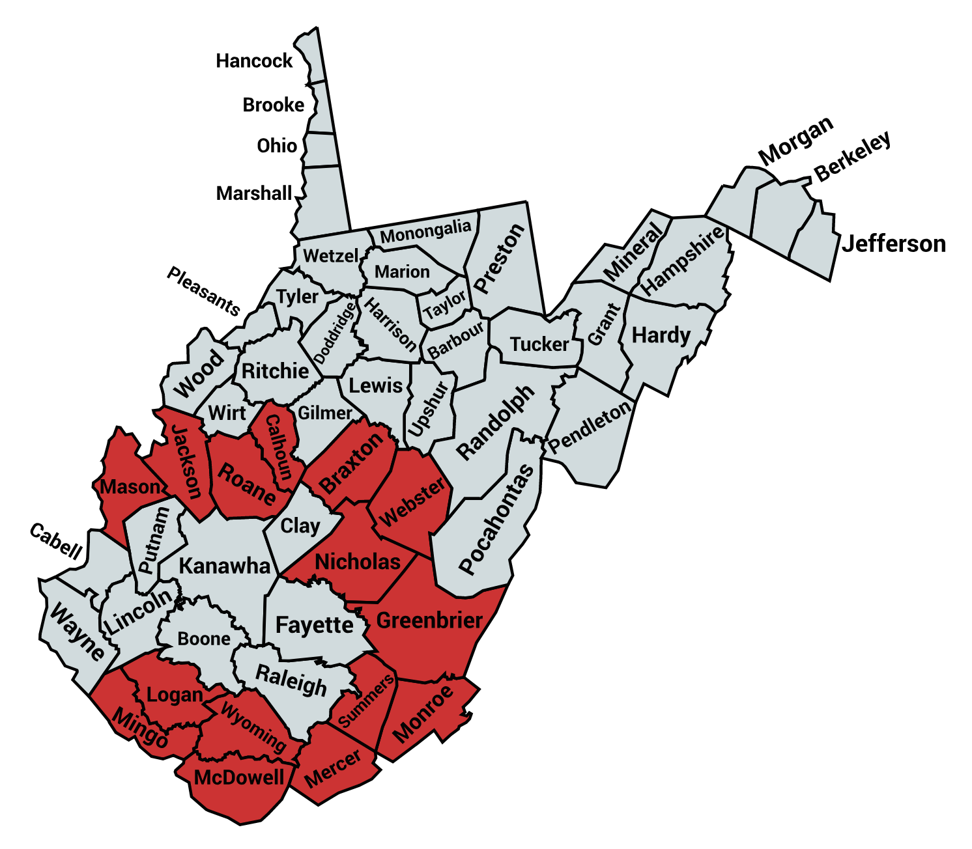
WEST VIRGINIA TARGET COUNTIES
Braxton (14,556)
Calhoun (7,903)
Greenbrier (36,888)
Jackson (29,634)
Logan (38,557)
McDowell (23,682)
Mason (27,616)
Mercer (61,460)
Nicholas (26,892)
Roane (14,644)
Summers (14,160)
Webster (9,286)
Wyoming (23,928)
TOTAL 329,206
Notes:
Here are the target counties in West Virginia.

Slide 27
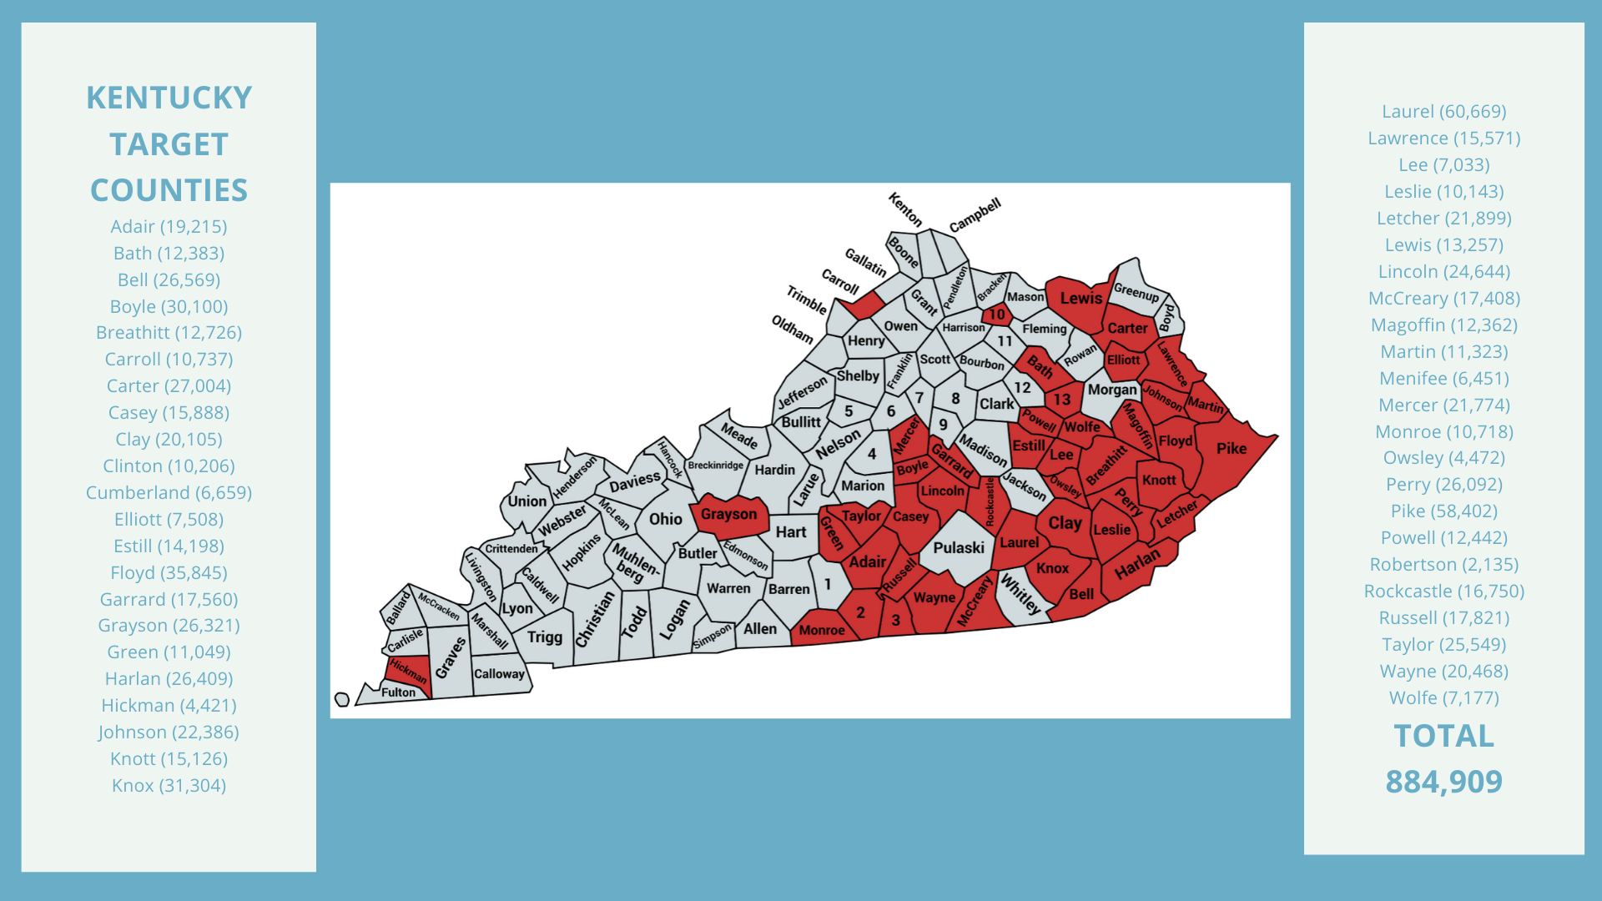
Notes:
Here are the counties in Kentucky.

Slide 28
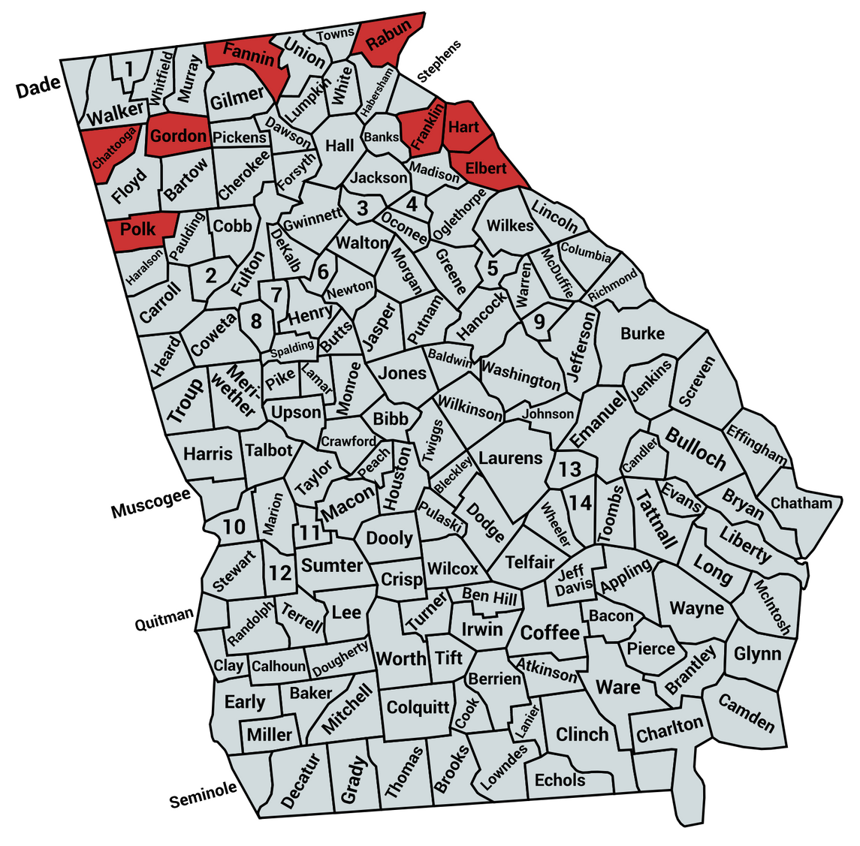
GEORGIA TARGET COUNTIES
Chattanooga (24,790)
Elbert (19,120)
Fannin (25,964)
Franklin (23,023)
Gordon (57,685)
Hart (265,099)
Polk (26,099)
Rayburn (42,470)
TOTAL 236,018
Notes:
And here are the counties in Georgia.

Slide 29
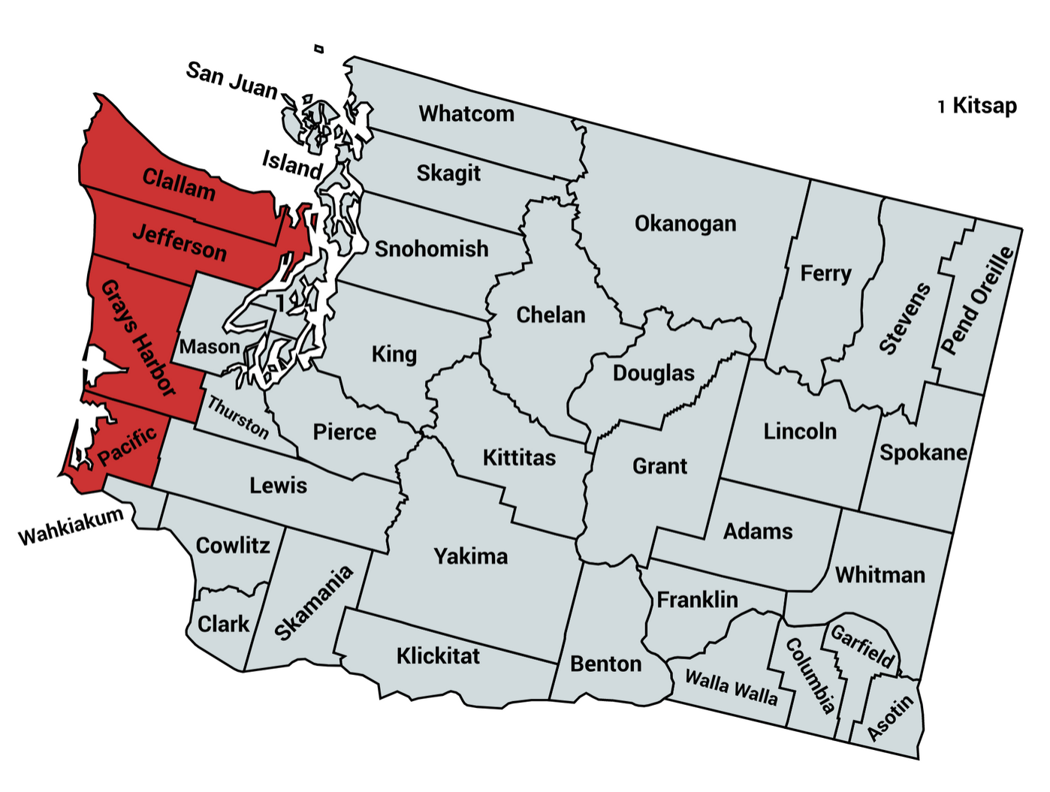
WASHINGTON
TARGET COUNTIES
Clallam (76,737)
Grays Harbor (73,901)
Jefferson (31,729)
Pacific (22,036)
TOTAL 204,403
Notes:
Out West we have four more states. In this slide we see the counties targeted in Washington state.

Slide 30
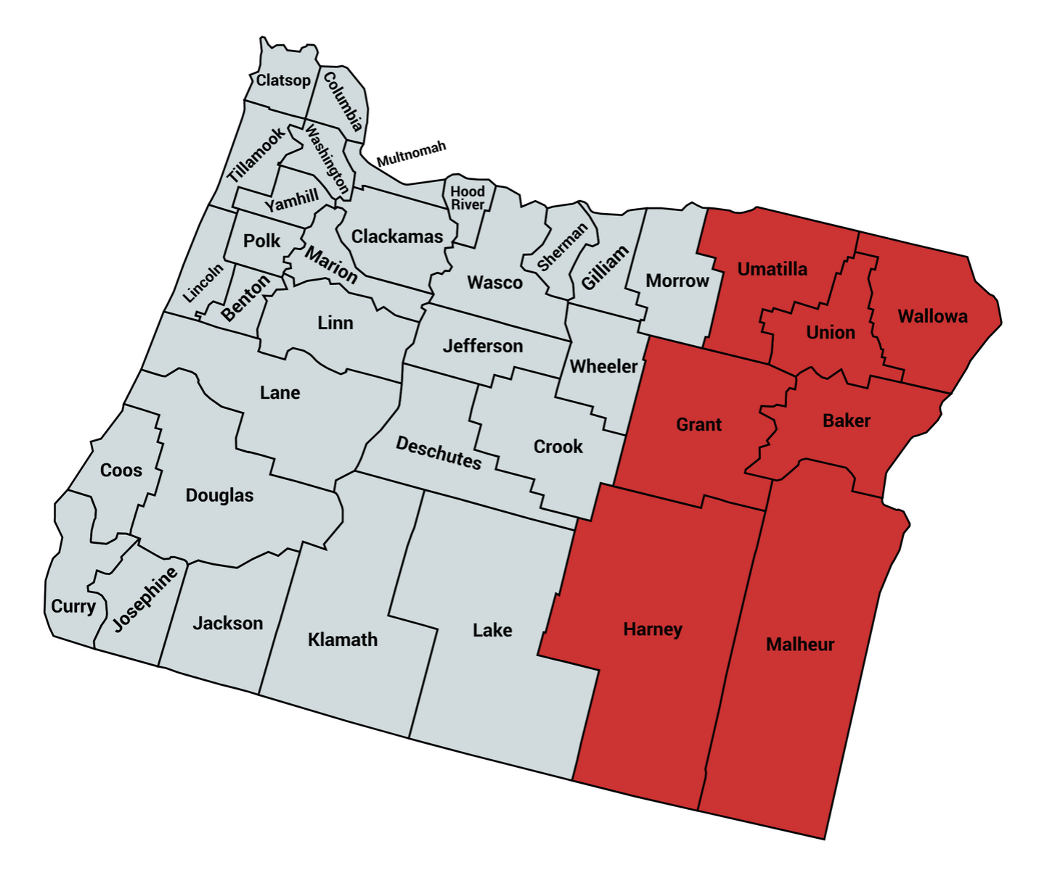
OREGON TARGET COUNTIES
Baker (16,006)
Grant (7,176)
Harney (7,329)
Malheur (30,725)
Umatilla (77,516)
Union (26,461)
Wallowa (7,081)
TOTAL 171,271
Notes:
Plus these seven in Oregon.

Slide 31
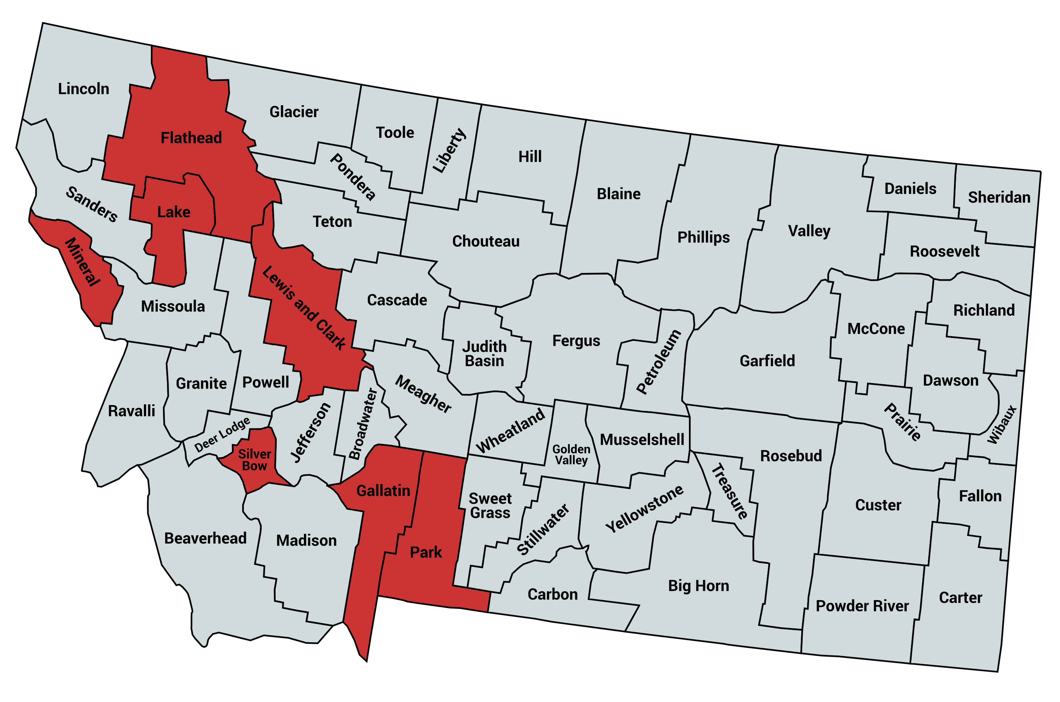
TARGET COUNTIES
Flathead (102,106)
Gallatin (111,876)
Lake (30,250)
Lewis and Clark (68,700)
Mineral (4,316)
Park (16,736)
Silver Bow (34,993)
TOTAL 368,977
Notes:
These seven in Montana.

Slide 32
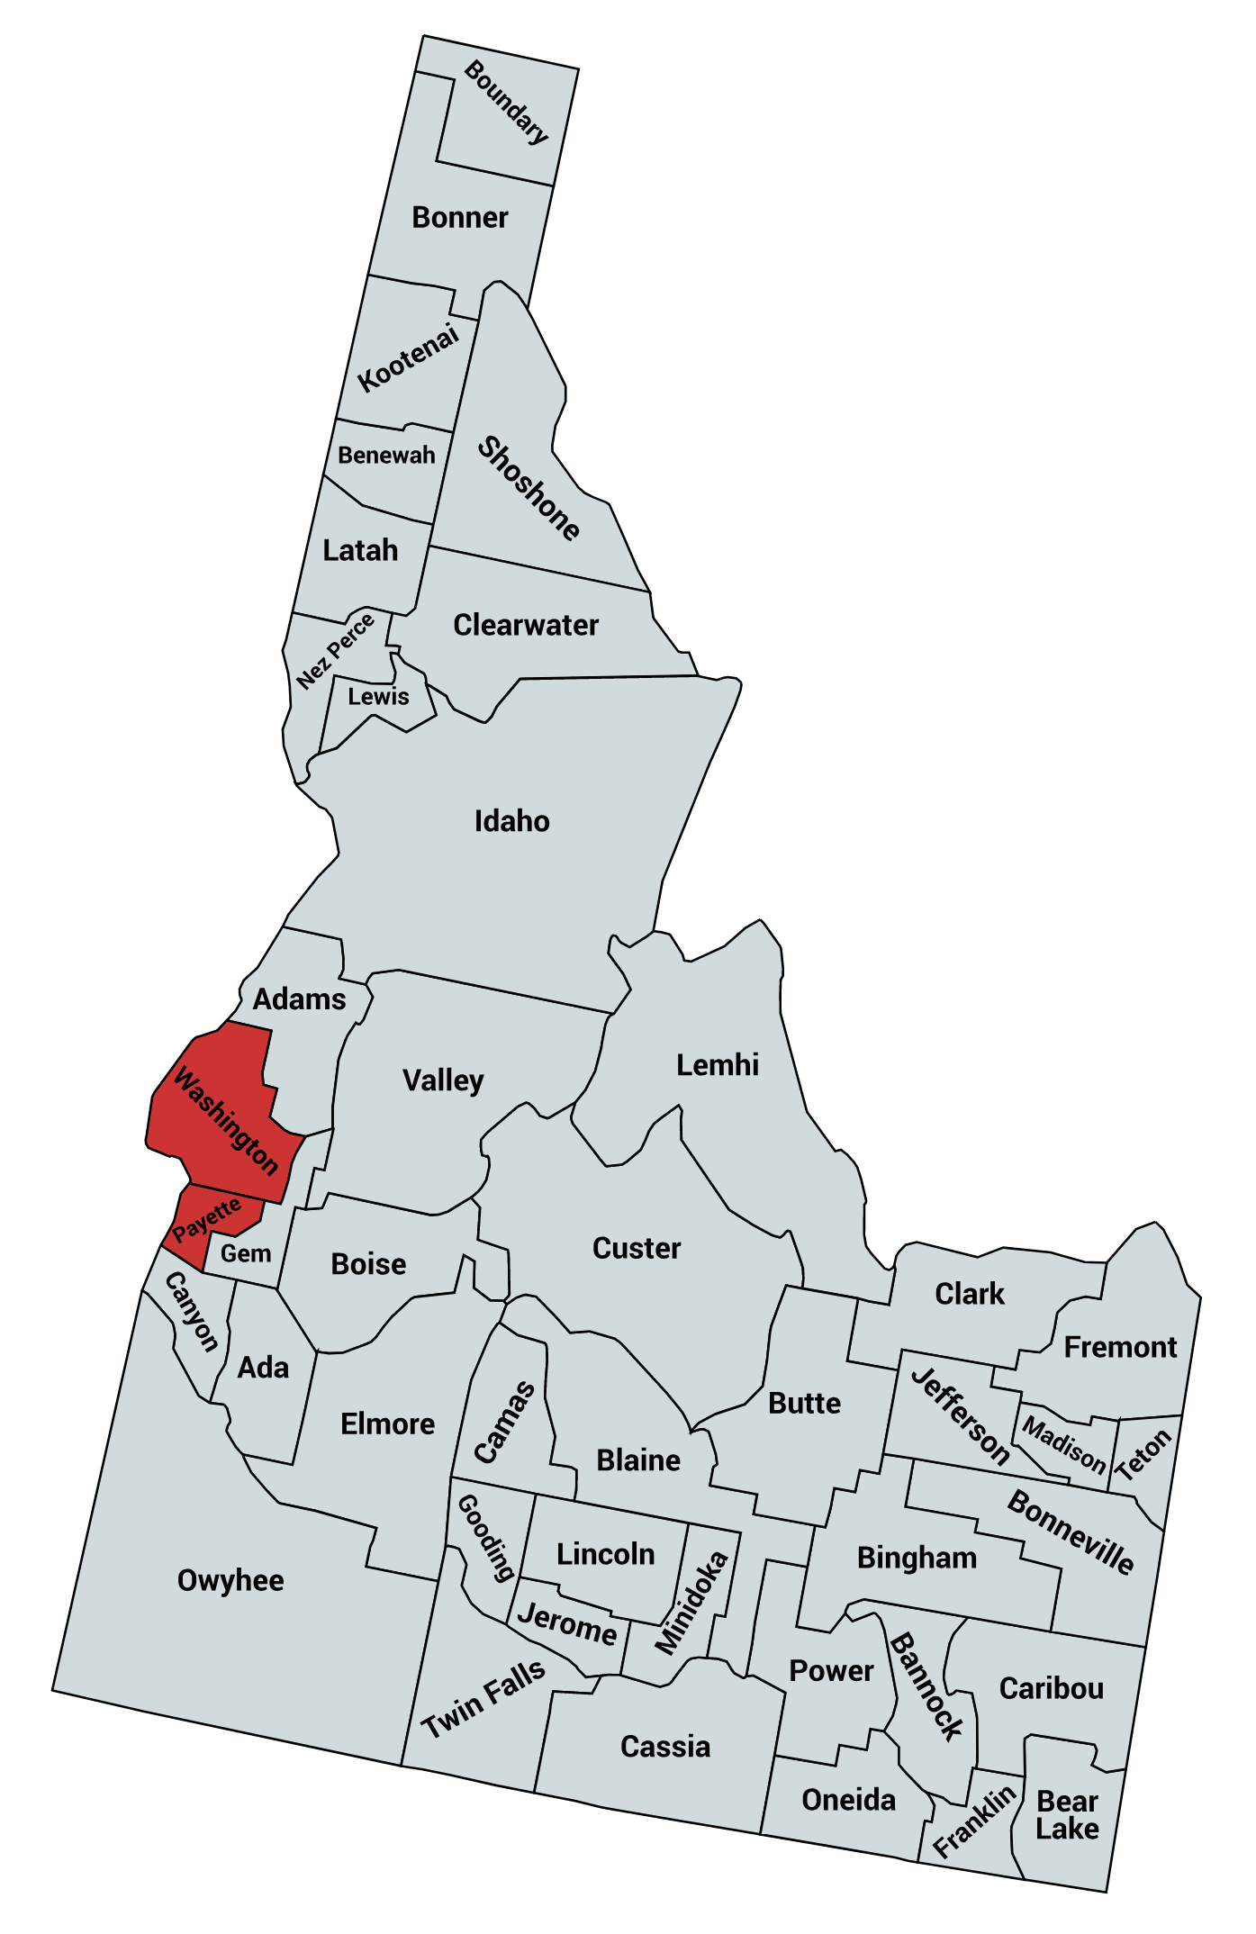
IDAHO TARGET COUNTIES
Payette (23,551)
Washington (10,161)
TOTAL 33,712
Notes:
And these two in Idaho.

Slide 34
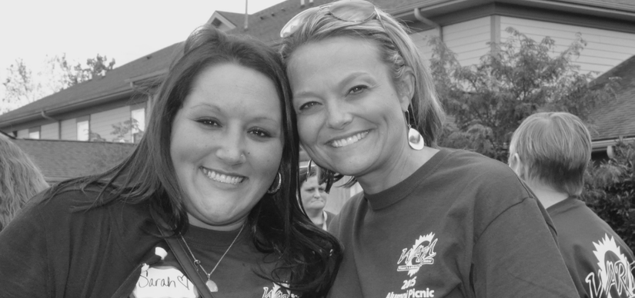
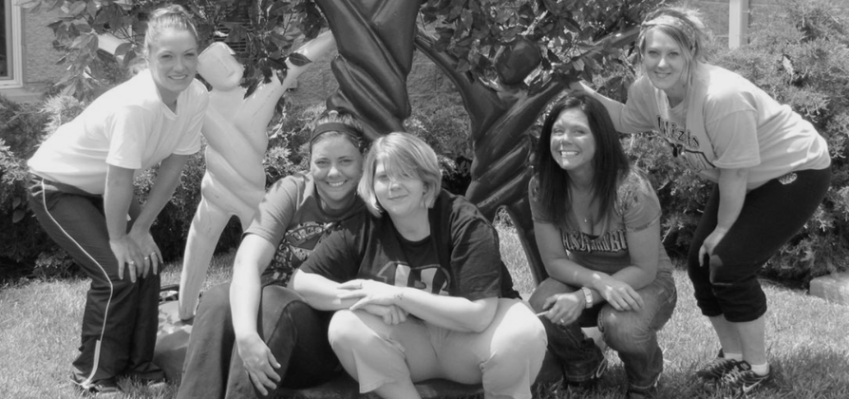
It’s All About People
“The program changed me and I’m now a peer mentor. I know about this disease better and have the tools to stay sober.”
“They truly, honestly care about me and want me to have a fruitful and productive future.”

Slide 35
Contact Information
ERNIE FLETCHER, MD
Fletcher Group Co-Founder
EMAIL ADDRESS
efletcher@fletchergroup.net
PHONE NUMBER
(606) 657-4662
WEBSITE
fletchergroup.org
Notes:
Here’s my contact info if you don’t have it already. And remember: There’s lots of more detailed information available on our website at fletchergroup.org.

