Slide 1
Amy Shanahan and Dawn DePasquale
6.28.21

Slide 2
First, a quick review of last week

Slide 3
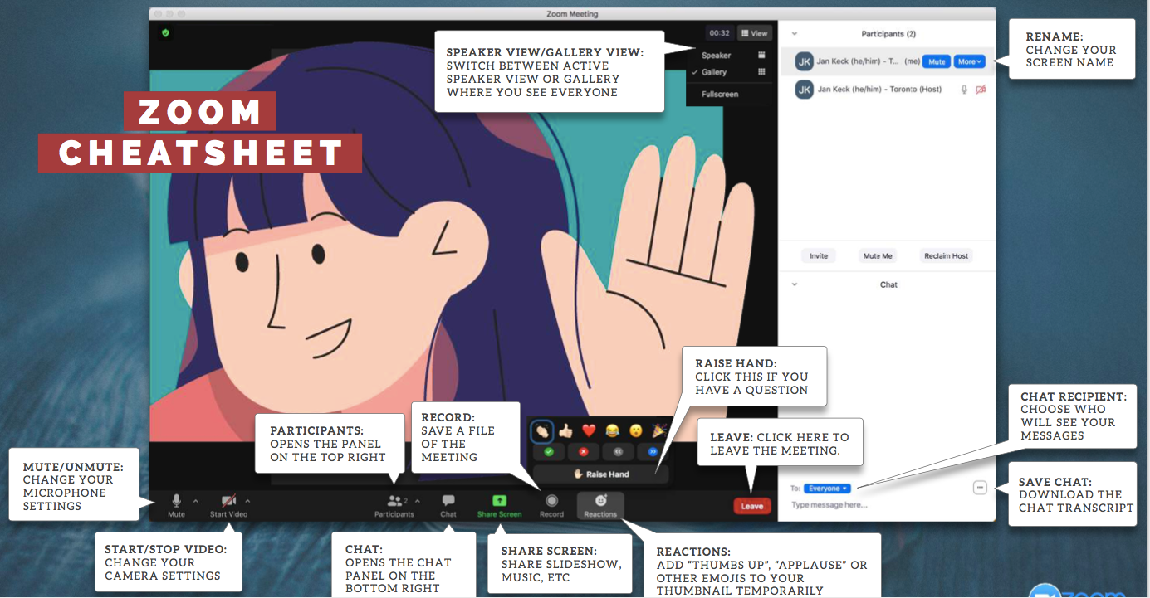

Slide 4
Goals for your Big Ideas
Workshops
Share each region’s most innovative programs, services, and delivery methods to demonstrate what’s possible, and what’s working!
Enable directors to develop collaborative and creative ideas.
Stretch beyond what is NOW, to what CAN be.
Share innovative ideas and innovative approaches with your teams.
Utilize skills and strategies to engage staff members.
Identify and communicate emerging vision
Capture and define your region’s vision to enhance grant applications.
Check mark 1 or 2 most important to you

Slide 5
Getting to know each other
1. Which of your facilitators watched a concert WITH Rick James (as in SITTING NEXT TO)?
Amy Dawn
2. Which of your facilitators gave Franco Harris Ferrero Rocher chocolates on a plane flight?
Amy Dawn
Use Chat for #1 and #2

Slide 6
Getting to know each other, Your turn
In a private chat, send to Amy 1 fact about you that people in this group would be surprised to know! Think about…
your 15 minutes of fame
a hobby
something you were known for in school
1 minute
We will intersperse these bits of curiosity throughout the sessions.
Use Private Chat to Amy

Slide 7
How to “be” with each other
PLEASE say or do this!.....
Mindset:
Be open to new ideas
Trust the process and give this a chance
Be willing to try new things
Be open to all ideas
Behaviors (what we say or do):
Encourage minority ideas or brainstorming
Allow us to respond via chat
Share openly and authentically
Generate new ideas
Don’t be distracted
PLEASE don’t say or do this….
Mindset:
Don’t get stuck in the past
Assume ideas to be more than provisional, at this point
Behaviors (what we say or do):
Be mindful of negative phrases such as "that will never work," or "we tried that before and it didn't work”
Force me to speak out loud first
Please be aware of saying “… that won't work in my region”
Any additions/edits - Private chat to Amy or Vanesssa - will share updates each meeting

Slide 8
Storyboard Current and Future
What’s going well?
What isn’t going well?
More flexibility to do intensive TA
More opportunities to collaborative virtually (e.g., virtual training)
Virtual deliveries are increasing our reach in more rural areas of our region
Uptake in virtual training
Extended learning sessions online
More regular contact with each other even through its virtual (positive side effect of SAMHSA disallowing in-person meetings)
Working as a team
Zoom fatigue
Overextending ourselves
No national or regional in-person meetings
Funding/timeline uncertainty
insufficient technical host capacity
Sustaining relationships with key stakeholders
One thing you’d like to change?
What keeps you ”up at night”?
Greater focus on documenting impact of TA efforts
One annual in-person all network meeting
Re-assign some staff
Increase collaborative efforts
Increase in-person contact/meetings
We are expected to do the same or more, but the funding goes less and less far – so we are overextended – I want expectations of what is possible to decrease/ be lowered
Stigma reduction
Navigating hybrid workplace
Funding
Keeping the whole team employed (funding)
Funding/timeline uncertainty
Too much to do
Additions/edit – private chat to Vanessa

Slide 9
What would this look like?
In your bottom 2 quadrants, which possibility energizes you the most for the impact it might make in your region? 1 minute
Grab a piece of paper and pen, and sketch out a rough draw of what the OUTCOME would look like if you were able to attain this vision.
In your breakout room of 2-3 colleagues, share
what you selected
why you selected it
what your visual of the outcome is if it could be attained
3 minutes each
Time yourselves for 3 minutes each

Slide 10
Cross-pollination
Name, title, region/chapter
Your top 2 CURRENT projects
What’s NEXT for you. List 2 initiatives. Use a verb. i.e. ”develop a social media strategy for a new service.”
2 things that people (who worked with you) would consider you an “expert” in, i.e. social media, writing grants, working, leading staff, exceeding needs of clients, etc. AND that you’d be willing to coach others on
2 things that you need help with “how to…….”
Email your response to Vanessa Mendoza at vmendoza@umkc.edu.

Slide 12
Next meeting
We will send an email reminder for info needed
6.28.21 noon to 1pm
“See” you then! Have a great week!
Dawn and Amy

Slide 13
Now, Big Ideas Session, 6.28.21!

Slide 14
Let’s celebrate small and large successes since last week!
In Chat or raise hand to share!

Slide 15
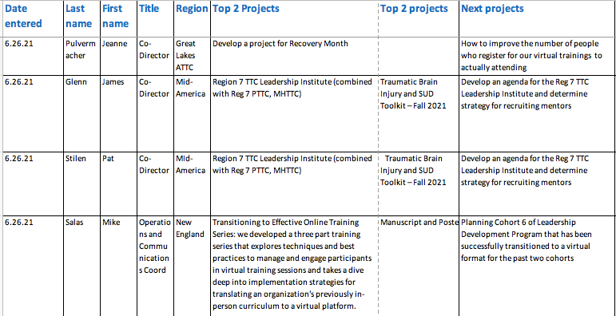
The tool that will get everyone “there”

Slide 16
Cross-pollination Insights – for those who have submitted their info
In chat, you’ll find a spreadsheet of what each of you shared.
Please pull it up, and within your group:
identify at least 3 things that you see in each others’ projects and expertise that might be opportunities for sharing insights, coaching each other, or collaborating within this network.
Pick a spokesperson and be prepared to share when we get back.
10 minutes

Slide 17
Cross-pollination Data – for those who haven’t submitted….do now, in private chat to Vanessa, or send email to her at vmendoza@umkc.edu
Name, title, region/chapter
Your top 2 CURRENT projects
What’s NEXT for you. List 2 initiatives. Use a verb. i.e. ”develop a social media strategy for a new service.”
2 things that people (who worked with you) would consider you an “expert” in, i.e. social media, writing grants, working, leading staff, exceeding needs of clients, etc. AND that you’d be willing to coach others on
2 things that you need help with “how to…….”
10 minutes

Slide 18
In Chat, type up ONE challenge that you’re currently facing – large or small.

Slide 19
One Barrier to Big Ideas
Negative Mindset
The tendency to focus on the negative aspects of problems and expend energy on worry.
One solution – Train our brains to use affirmative judgment – ask ”what’s RIGHT with this idea?”
Notes:
Unhappiness with your job, personal life other. Use as an opportunity

Slide 20
Mindset – why it’s important
It is more than just a skill.
A person with a problem-solving mindset:
- sees what’s RIGHT with some part of the solution
- sees a problem as an opportunity to grow
- is motivated to find solutions,
- is focused on achieving positive results.

Slide 21
Tool: Reframing the challenge – your turn
Your turn!
Scroll back up chat to find your original “challenge”
Next…change it into a problem statement…”how to..” or “in what ways might I…”
In Chat, post your challenge in the new problem statement format
In pairs, share what your written issue was, and now how it sounds as a problem statement.
How did it change your mindset?
1 minute
1 minute each

Slide 22
Tool: Reframing the challenge
Is your challenge more approachable and doable with the re-framing into a problem statement?
Please put up your “hand” if yes

Slide 23
Tool: Ladder of Abstraction – what it is
Sometimes your problem statement might be generated too broad or too concrete to solve the “root issue”. We need to “land” on the right level of “abstraction” to be sure that we’re solving the right problem.
Ex: I need money to buy a car to get to work.

Slide 24
Tool: Ladder of Abstraction – how it works
This tool helps individuals/groups shift the focus of thinking by exploring different levels of abstraction and concreteness.
I want to solve world peace
vs
I’d like to make a new friend
“WHY” gets you to bigger picture problem statements and/or root issues?
“HOW” gets you to more concrete thinking and action steps.
Notes:
We want to make sure we are solving the right problem. Asking a “Why?” question about a task helps to identify a broader view or a higher level of abstraction.
Asking, “How?” leads to a more specific or concrete view of the task and moves down the ladder.
Asking, How else or Why else? Stimulates a search for other options at the same level of abstraction

Slide 25
Tool: Ladder of Abstraction - example
To be more sociable
To make money
Travel with friends
Why else?
Why?
Why else?
To date
To get to work
Explore my region
Why else?
Why?
Why else?
To shop
To be mobile
Go out more
Why else?
Why?
Why else?
I need to buy a car
How else?
How?
How else?
Join a carpool
Use public trans
Buy a motorcycle
How else?
How?
How else?
Call Uber
Rent a car
Share a car
How else?
How?
How else?

Slide 26
Tool: Ladder of Abstraction – your turn
Your turn!
Build on your problem statement, ask yourself 3 whys…
Example:
Alternate problem statement: In what ways can we make sure our clients receive the services they need?
To make sure our clients receive the services they need
why?
To have more money to expand services
why?
In what ways might we (IWWMW) attract grant funding?
2 minutes

Slide 27
Team Tips
When team members share ideas
- model using affirmative judgement, i.e., ask “what’s right with this idea”
reframe complaints about things that are wrong into problem statements, i.e. “Thanks for bringing that up. So how would we ________?”
check that the problem statement is at the right “level of abstraction/concreteness to hit the root issue, i.e. ask “why”
explore the space around a challenge by asking ”why else” or some ideas for how to do it by asking “how.”

Slide 28
Next meeting: Thursday, July 8, 3pm EST
“See” you then! Have a great week!
Dawn and Amy

