Slide 1
Information Memorandum on the Intersections of Domestic Violence, Mental Health and Substance Use Issued by the: Administration for Children and Families (ACF)
Substance Abuse and Mental Health Services Administration (SAMHSA) U.S. Department of Health and Human Services (DHHS)

Slide 2
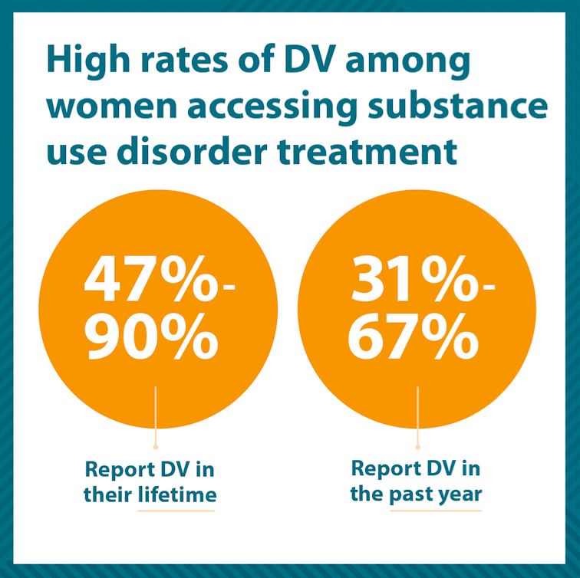
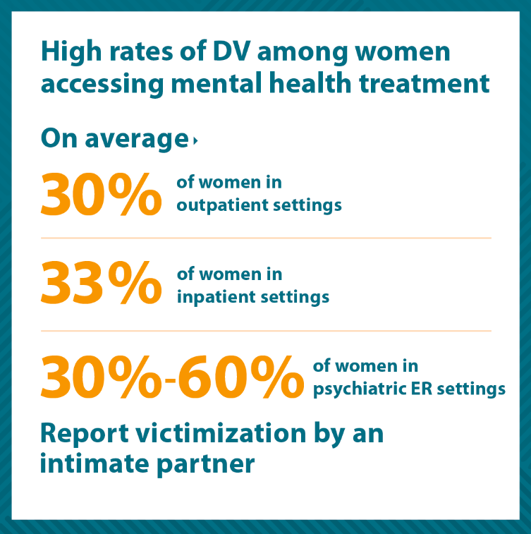
Domestic violence can have traumatic mental health and substance use effects, and is prevalent among people accessing mental health and substance use treatment

Slide 3
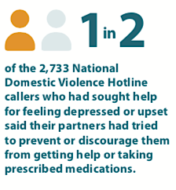
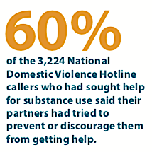
Domestic violence is often targeted toward undermining a partner’s mental health or substance use disorder treatment and recovery

Slide 4
Experiencing a mental health or substance use disorder places individuals at greater risk for being controlled by an abusive partner
Stigma associated with substance use and mental illness contributes to the effectiveness of abusive tactics and can create barriers for survivors when they seek help

Slide 5
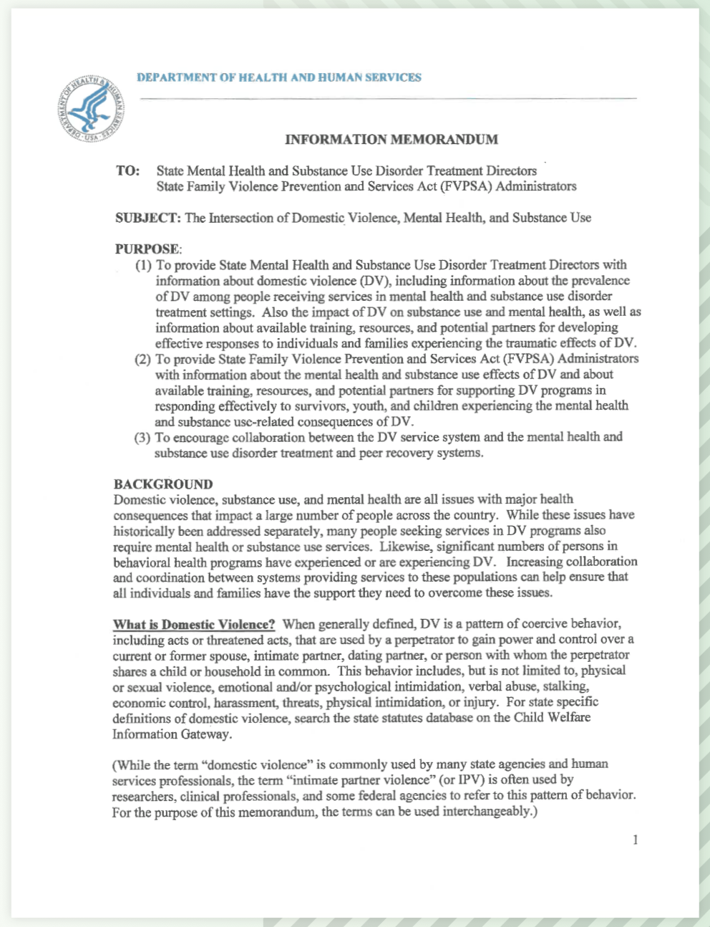
In order to address these critical intersections, SAMHSA and ACF have issued an Information Memorandum on DV, substance use and mental health, in collaboration with NCDVTMH.
The Information Memo provides:
research,
resources, and
recommendations for state and local providers and systems.

Slide 6
Purpose of the Information Memorandum
Provide State Mental Health and Substance Use Disorder Treatment Directors with:
Information about domestic violence, including the prevalence of DV among individuals receiving services in mental health and substance use disorder treatment settings
Evidence of the impact of DV on substance use and mental health
Available training, resources and potential partners for developing effective responses to individuals and families experiencing DV
Provide State Family Violence Prevention and Services Act Administrators with:
Information about the mental health and substance use effects of domestic violence
Available training, resources, and potential partners for supporting DV programs in responding effectively to survivors, youth, and children experiencing the mental health and substance use-related consequences of DV

Slide 7
Here’s What You Can Do
Download the full Information Memorandum at bit.ly/DVcollaboration
View our Partners Guide with suggested talking points, social media posts and infographics at: https://bit.ly/2Ong9QL
Join us for a webinar on October 16, 2019 at 2pm CDT
→ Click here to register link: http://ncdvtmh.webex.com

Slide 8
Ultimately, optimally serving individuals, children and families affected by DV requires services that incorporate the expertise of the mental health, substance use disorder, and DV fields while attending the unique issues faced by DV survivors and their children.
Visit https://bit.ly/2Ong9QL to explore:
The full Information Memorandum
Strategies for State Mental Health and Substance Use Disorder Treatment Administrators
Strategies for FVPSA Administrators
Resources and technical assistance
Contact: Carole Warshaw MD
P: 312-726-7020
TTY: 312-726-4110
www.nationalcenterdvtraumamh.org
cwarshaw@ncdvtmh.org
Twitter: @ncdvtmh

