Slide 1
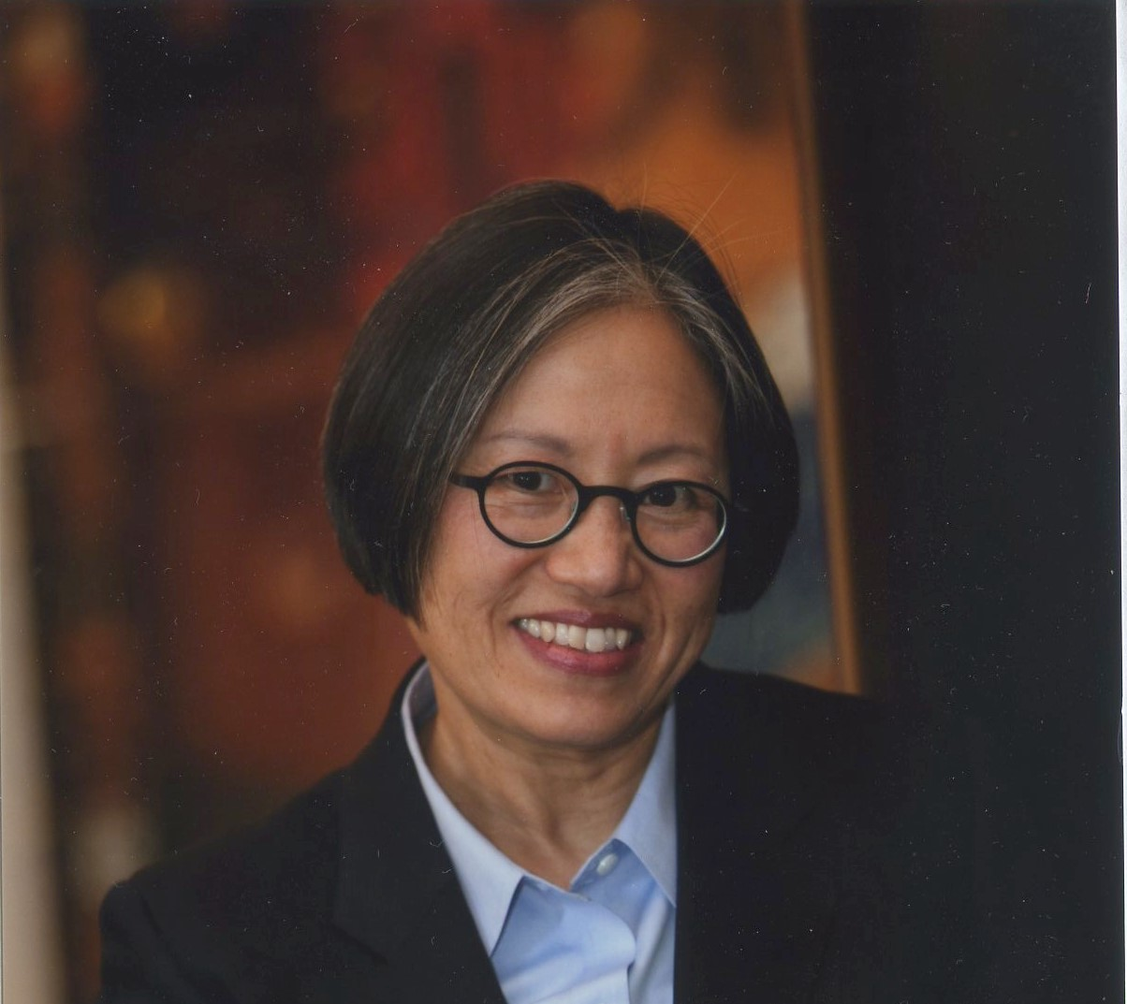
The Interagency Work Group on Drinking and Drug Use in Women and Girls is Pleased to Announce the Following Presentation
SCREENING FOR ALCOHOL AND DRUG USE IN THE ANTEPARTUM: CURRENT APPROACHES AND NEW OPPORTUNITIES
Friday, June 11, 2021
11:00 am – 12:00 pm EST
WebEX link:
http://bit.ly/antepartum
This event is open to the public. No registration required.
Individuals needing sign language interpretation should contact Deidra Roach at droach@nih.gov at least 5 days prior to the event.
GRACE CHANG, MD, MPH
PROFESSOR OF PSYCHIATRY
HARVARD MEDICAL SCHOOL
HEAD OF HARVARD PSYCHIATRY
VA BOSTON HEALTHCARE SYSTEM

