Slide 1
UM System Big Picture Fiscal Procedures
April 22, 2022

Slide 2
Agenda Part 1: 11am-12pm
Introduction
Procurement at a glance
Contracting with outside entities
Consultants
Subcontractors
Hotels
IT
POs
Non-POs
Break 12pm-1pm

Slide 3
Introduction
Thank you!
Why is this training important?
Reputation
Reporting

Slide 4
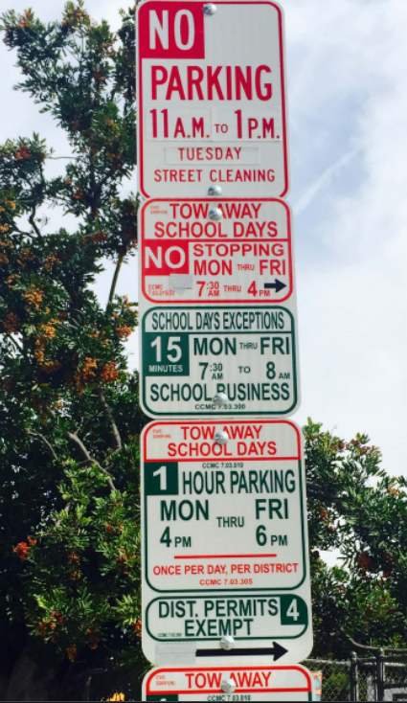
Like this parking sign, fiscal operations
within the UM System can be tricky! Don’t be scared! We are here to help!

Slide 5
What is Procurement?
Authorization to purchase
MoCodes
Account Codes
Volume Purchase Agreements

Slide 6
Contracting with Outside Entities
Consulting agreements
Service Agreements
Appearance Agreements
Consultants
Subcontractors
Hotels
IT Contracts/Agreements

Slide 7
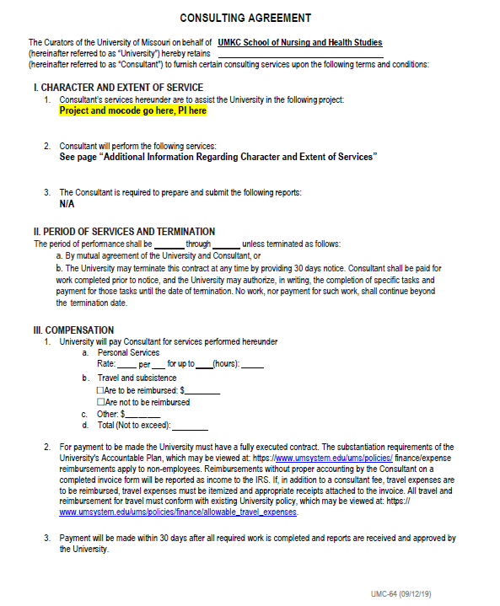
Consulting Agreement
Who is considered a consultant?
Are they employed at the University or UM System in any capacity?
What should the period of performance be?
Who signs the agreement?
What is needed from the consultant?
W-9
W-8
Do they need “Liability and Insurance”?
What to do if travel is required of the consultant?
Who creates the Scope of Work (SOW)?
How do they get paid?

Slide 8
Service Agreement
Used only in special circumstances
Examples may include but are not limited to:
Janitorial services
Language services
Translation
Transcription
Interpreting
Media captioning

Slide 9
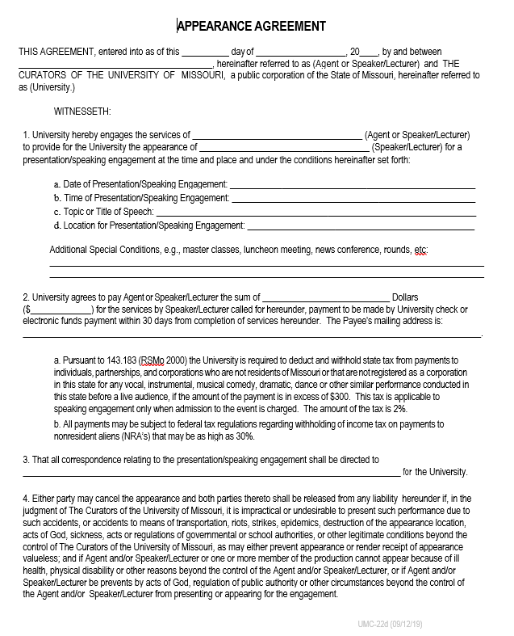
Appearance Agreement
What is an Appearance Agreement?
Who can we contract with?
When do we use them?
Is a W-9/W-8 required?
Who signs?
How do they get paid?

Slide 10
Subcontracts
What is a subcontract?
Who do we subcontract with?

Slide 11
Hotel Agreements (space rentals)
When/why do we contract with Hotels?

Slide 12
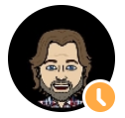
IT Contracts/Agreements
Platforms
Software
Subscriptions
Consultants that require IT/IS approval
Approvals before purchases
Curby
Key Take Aways:
If you have to accept terms & conditions, it requires pre-approval
Plan Ahead
All requests should be submitted via CAHS Zendesk

Slide 13
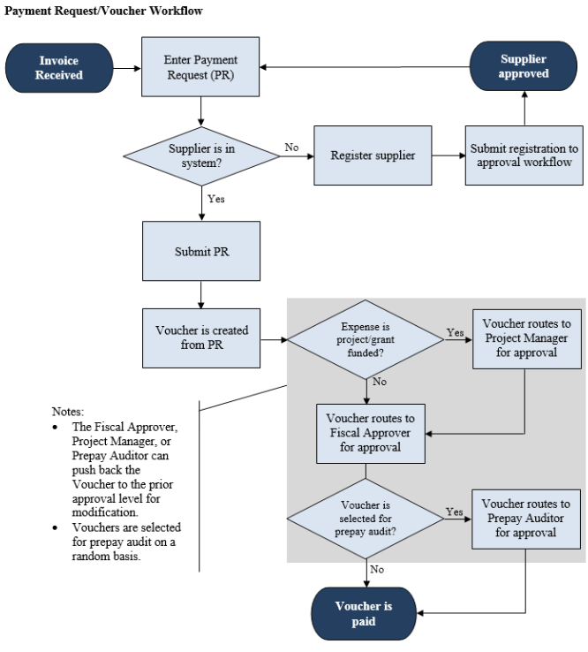
Paying Outside Entities
UMKC turn around times on payments
Net10, Net15, Net30 etc.
Direct deposit
W-9 or W-8

Slide 14
PO vs. Non-PO
What is a PO
When do we need to use a PO?
How are POs paid?
What is a Non-PO?
When do we use Non-POs?
How are Non-POs paid?

Slide 15
Agenda Part 2: 1pm-2pm
ZenDesk
Travel
OneCard Purchases – high level overview
RIF
Fiscal Team office hours
Fiscal contacts
Conclude

Slide 16
ZenDesk
Generally speaking, anything that needs to be paid should be submitted through ZenDesk.
Please also submit W-9s, W-8s, appearance agreement requests, consulting agreement requests, invoices, etc. via ZenDesk.

Slide 17
Travel
Pre-travel authorization form
We are a Tax-Exempt institution
Utilize the UM Tax-exempt letter when checking into a hotel or renting a car
Not all states recognize our exempt status – but still ask
Use per diem when traveling

Slide 18
OneCard Purchases
If you have a OneCard for purchases and/or travel
Do not use it on food (unless you have written approval from the Dean)
Use per diem – amount will auto generate based on the city you travel to
Reconcile purchases as soon as they hit your “MyWallet”. “Why is this important” you may ask?

Slide 19
RIF
What is it?
Can you use it?
Approval?

Slide 20
Extras
Anything over $10k
Sole Source (competitive bidding)
Approvals

Slide 21
Fiscal Contacts for Questions
Sharon Colbert – Hotels (space rentals)
Katey Collins – Fiscal, Contracts
Erin Hobbs – IT/IS agreements, ZenDesk
Stephanie McIntosh – Fiscal, Contracts
Krystal Olmos-Romero – Fiscal, Contracts
Kelly Reinhardt – Operations
Brizhana Ricks – Fiscal, Contracts
Nancy Bahner: Fiscal Officer for SoNHS - BahnerN@umkc.edu
Try and contact the CAHS team first before going to Nancy

Slide 22
Cash Fiscal Team Open Office hours
Time/day TBD

Slide 23
Helpful Links
Accounts Payable https://www.umsystem.edu/oei/sharedservices/apss
OneCard info https://www.umsystem.edu/ums/fa/procurement/card/one_card
Tax-exempt info https://www.umsystem.edu/ums/fa/procurement/travel-tr106
Employee per diem info https://www.umsystem.edu/oei/sharedservices/apss/travel_and_expense/per_diem_information
Current MoCodes and Fiscal Contacts https://umkc.box.com/s/d4eyzagyvojlqbwnqywpgwidt6cmq81g
Suppliers available in ShowMeShop
https://www.umsystem.edu/ums/fa/procurement/epro/suppliers
Travel Approval Form https://net3.umkc.edu/intapps/travelrequest/User

Slide 24
Q & A

Slide 25
Thank you!!!

