Slide 1
Construyendo Puentes para Mejores Resultados
Superando las Barreras: Identificando y abordando desafíos comunes
Sesión 2

Slide 2
Sesión 2 Objetivos
Enumerar las barreras para la implementación.
Discutir el impacto de estas barreras en el éxito de la implementación.
Generar ideas para superar las barreras.

Slide 3
Repasar Sesión 1
Oportunidad de Aprendizaje – Videos: Teorías & Marcos teóricos; ¿Qué es la ciencia de implementación?
Notes:
What key things stood out from our discussion?
What things were interesting to you after watching the videos?

Slide 4
Barreras
Recursos
Resistencia al cambio
Acesso
Capacitación inadecuada
Cultura organizacional
Falta de colaboración
Aspectos políticos o legales
¿Otros?
Notes:
Break out groups to share specifics about types of barriers
Resistance – includes relationship to time and resources for changing existing systems, policies and procedures
Resources – funding, staff, technology
Limited Access to evidence – might relate to identifying which practices are most effective and how to implement them
Inadequate training – staff may lack the knowledge and skill training
Organizational culture – this could relate to values and traditions that are not in concert with the EBP
Lack of collaboration – agencies spread thin - limited resources or support from leadership
Political and legal factors – regulations and policies that may hinder adoption of certain practices - funding

Slide 5
Impacto de las Barreras
Notes:
Debrief small group discussion and explore the impact of the barriers.

Slide 6
Superando las barreras
Asistencia técnica para promover la adopción del cambio
Convorcar comunidades de aprendizaje
Proveer capacitación y asistencia técnica
Desarrollar un programa de capacitación y “cajas de herramientas”
Desarrollar seminarios en línea/webinars para expandir el acesso a la información
Desarrollar normas y estandardes nacionales de tratamiento
Desarrollar líneas de asistencia telefónicas
Notes:
Here’s a list of examples from the US, and other TTCs – Using the chat or annotation tool (go to next blank slide) - together let’s identify some things you’re already doing and ideas you have from this list or each other
Topics include: SUD, MOUD, Trauma, PTSD, CBT, MI, CM, Screening and Assessment, Pharmacotherapy and Psychosocial interventions.
Vietnam: The United Nations Office on Drugs and Crime (UNODC) has partnered with the Vietnamese government to support the implementation of evidence-based practices in drug treatment and rehabilitation. UNODC has provided training to health care providers in Vietnam on evidence-based practices such as cognitive-behavioral therapy and contingency management. In addition, UNODC has helped to develop national treatment guidelines and standards to improve the quality of care provided to individuals with substance use disorders.
South Africa: The South African Depression and Anxiety Group (SADAG) has developed a national helpline to provide support and referrals for individuals with mental health conditions. SADAG has also created a network of support groups and trained lay counselors to provide peer support and basic counseling to individuals with mental health conditions. In addition, SADAG has worked to raise awareness about mental health and reduce stigma through public education campaigns.
Ukraine: The International Renaissance Foundation has provided support to organizations in Ukraine to promote the implementation of evidence-based practices in substance use disorder and mental health care. The foundation has provided funding to support the development of treatment protocols and guidelines, as well as the training of health care providers in evidence-based practices. In addition, the foundation has worked to promote the integration of mental health and substance use disorder services in Ukraine's health care system.
The Peruvian National Institute of Mental Health (INSM) has developed guidelines for the treatment of mental health and substance use disorders in Peru. These guidelines include recommendations for evidence-based practices, such as cognitive-behavioral therapy, motivational interviewing, and contingency management.
The Center for the Study and Prevention of Drug Abuse and AIDS (CEDRO) has developed a training program for health care providers in Peru to improve their knowledge and skills in the treatment of substance use disorders. The training program includes modules on evidence-based practices, such as motivational interviewing, behavioral couples therapy, and contingency management.
The Peruvian Society of Psychiatry (SPP) has worked to promote the integration of mental health and substance use disorder services in Peru's health care system. SPP has advocated for the development of national treatment guidelines and standards to improve the quality of care provided to individuals with mental health and substance use disorders.
The Peruvian National Institute of Health (INS) has conducted research on the effectiveness of evidence-based practices in substance use disorder treatment. INS has published studies on topics such as medication-assisted treatment, contingency management, and cognitive-behavioral therapy to inform the development of national treatment guidelines and standards.
These examples demonstrate how organizations in Peru have developed guidelines, training programs, and research studies to promote the implementation of evidence-based practices in substance use disorder and mental health care. By promoting evidence-based practices and advocating for the integration of mental health and substance use disorder services, these organizations have helped to improve the quality of care provided to individuals with substance use disorders and mental health conditions in Peru.

Slide 7
Compartir ideas

Slide 8
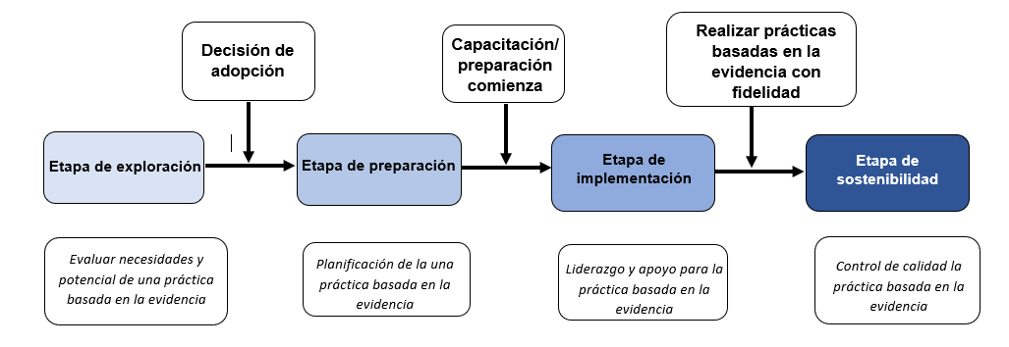
Etapas del modelo EPIS
https://episframework.com/what-is-epis
Notes:
Use annotation tool and chat to consider the EPIS framework as an example of how it can guide where we are.
If we are generating ideas and considering ways to remove barriers – we may be in the exploration phase. If we know what EBPs we are considering and we are brainstorming ways to disseminate, remove barriers, and implement – we may be in the preparation phase. If we’ve already done some training and want to increase buy-in and more robust adoption – we may be in the implementation phase.
There may be some overlap and we may be at different points for different activities.
Using the models and frameworks can be guides that we use to help strengthen adoption and sustainability of EBPs
What do you think? How do you see other models working for you?

Slide 9
Oportunidad de aprendizaje
Estrategias de Implementación -
Notes:
Watch 16 min. video and prepare to discuss highlights you find helpful.
https://youtu.be/0iRH51tAzrc

