Slide 1
A Question for You…
What assessment activities relate to prevention ethics, including equity and social justice?
Data Collection Methods
Sampling
Communication and Presentation
Reporting
Confidentiality and Security
Analysis
Notes:
Poll question (select all that apply)
What data processes relate to prevention ethics, including equity and social justice?
Data Collection Methods
Sampling
Communication and Presentation
Reporting
Confidentiality and Security
Analysis

Slide 2
Dismantling Power and Privilege Through Data: Prevention Ethics, Equity and Social Justice
Facilitator: Nicole Schoenborn
Date: August 23, 2022
South Southwest Prevention Technology Transfer Center
Notes:
Introductions: Name, Where from

Slide 3
Acknowledgement
This presentation was prepared for the South Southwest Prevention Technology Transfer Center (PTTC) Network under a cooperative agreement from the Substance Abuse and Mental Health Services Administration (SAMHSA). All material appearing in this publication, except that taken directly from copyrighted sources, is in the public domain and may be reproduced or copied without permission from SAMHSA or the authors. Citation of the source is appreciated. Do not reproduce or distribute this publication for a fee without specific, written authorization from the South Southwest Prevention Technology Transfer Center. For more information on obtaining copies of this publication, contact us at pttc6@ou.edu At the time of this publication, Miriam E. Delphin-Rittmon, Ph.D, served as Assistant Secretary for Mental Health and Substance Use in the U.S. Department of Health and Human Services and the Administrator of the Substance Abuse and Mental Health Services Administration. The opinions expressed herein are the view of PTTC Network and do not reflect the official position of the Department of Health and Human Services (DHHS), SAMHSA. No official support or endorsement of DHHS, SAMHSA, for the opinions described in this document is intended or should be inferred. This work is supported by grants 6UR1TI08205-02M002, SM081726 and 1H79SP081006-01 from the Department of Health and Human Services, Substance Abuse and Mental Health Services Administration.

Slide 4
Facilitator
Nicole Schoenborn, M.A., CPS
Evaluator
South Southwest Prevention Technology Transfer Center
Notes:
Bio

Slide 5
Our Roadmap Today
Defining Data Equity and Justice
Ethics and Professional Behavior in Data-related Prevention Activities
Tips for Ensuring Equity and Justice with Data
Example Data Ethics Scenarios-Let’s Hear from You!
Resources for Data Equity and Justice
Notes:
Photo: https://pixabay.com/photos/woods-trees-pathway-forest-green-945405/

Slide 6
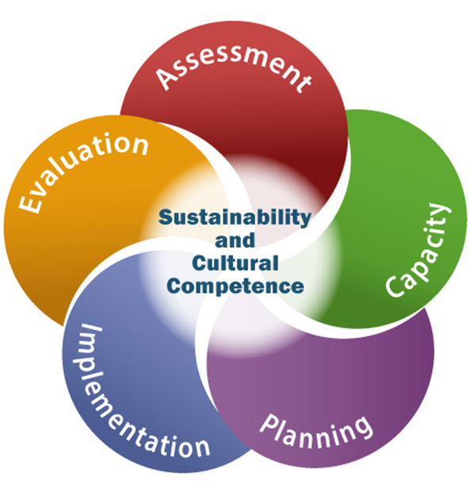
Data and the Strategic Prevention Framework
What areas of the SPF do you feel data plays a role?
How have you used it in your work?
What are the benefits?
Notes:
How many are familiar with the SPF (Raise hands)
Brief overview if many are not familiar.
Chat questions:
What areas of the SPF do you feel data plays a role?
How have you used it in your work? How?
What are the benefits?
https://www.samhsa.gov/sites/default/files/20190620-samhsa-strategic-prevention-framework-guide.pdf
 Data-driven. The SPF is designed to help planners gather and use data to guide all prevention
decisions—from identifying which substance misuse problems to address in their communities,
to choosing the most appropriate ways to address these problems, to determining whether
communities are making progress.
policy of collecting data to determine a priority problem seems neutral, but that data collection is not. It is fraught with pit falls to disadvantage people. Pitfalls such as where, who, how, what data are collected.

Slide 7
How does data relate to prevention ethics?¹
Presenting data publicly in ways that protect participants.
Advocating on behalf of the public and the individual’s right to services.
Educating the public and policy makers around prevention issues that need attention.
Gathering input from service recipients.
Ensuring that data collected is secured.
Collecting information that is necessary and relevant.
¹ International Certification and Reciprocity Consortium (2017). Prevention Think Tank Code of Ethical Conduct. https://www.internationalcredentialing.org/resources/Documents/Prevention%20Think%20Tank%20Code%20of%20Ethical%20Conduct.pdf
Notes:
Few people—other than evaluators and epidemiologists—relish the idea of working with data. But there are many good reasons for understanding data and how it applies to prevention ethics. And this is where we have some commonalities with our goals as prevention professionals --using data in an ethical manner creates positive change in the communities you serve.
Gathering input from service recipients in the development, implementation, and evaluation of prevention services.
Ensuring that data collected is secured.
Collecting information that is necessary and relevant, and accessible only to appropriate personnel.
Presenting data publicly in ways that protect the confidentiality of individual participants.
Using data to advocate on behalf of the public and the individual’s right to services, educating the general public, and policy makers, around prevention issues that need attention.
Using data effectively helps facilitate project reporting and grant requirements.
Additionally, data can serve as a communication tool to some of your identified stakeholders around policies or priorities in your community. Data helps illustrate where your program is going and why.
Finally– data is key to assessment and evaluation, steps in the SPF. It helps us identify what we want to see change and what we want to measure.

Slide 8
Data Equity and Data Justice
How would you define data equity?
What about data justice?
Notes:
Microsoft Stock Photo
Chat: How would you define data equity?
What about data justice?

Slide 9
Data Equity
The consideration of the ways in which data is
Collected
Analyzed
Interpreted
Distributed
Through an Equity Lens
Notes:
The term “data equity” captures a complex and multi-faceted set of ideas. It refers to the consideration, through an equity lens, of the ways in which data is collected, analyzed, interpreted, and distributed. It underscores marginalized communities’ unequal opportunities to access data and, at times, their harm from data’s misuse. It raises the issue of data sovereignty, and the democratization of data. And data equity pushes us to consider the ways that data can reinforce stereotypes, exacerbate problems like racial bias, or otherwise undermine social justice.

Slide 10
Data Justice
Tied to the ethics of
Data Privacy
Decision Making
Concerns regarding power and privilege
Notes:
“Data justice,” a term that at times is used interchangeably or in close relation to “data equity,” has been tied to the ethics of personal data privacy, big data, and decision making that results from the “datafication” of modern society. But it is also used to encompass the complex meanings that data equity captures, including concerns regarding power and privilege, knowledge equity, and the ways that harmful decision making may be justified or maintained through data.
Chat Question: How have you seen data used in a harmful way to maintain power and privilege?

Slide 11
What about Prevention?
How are you bringing data equity to your prevention work?
How can prevention address power imbalances with data collection and use?
Notes:
Microsoft stock photo

Slide 12
Our Why
“Right or wrong, research can drive decisions. If we do not address the power dynamics in the creation of research, at best, we are driving decision-making from partial truths. At worst, we are generating inaccurate information that ultimately does more harm than good in our communities. This is why we must care about how research is created.” ¹
¹ Chicago Beyond Equity Foundation (2018). Why Am I Always Being Researched? https://chicagobeyond.org/wp-content/uploads/2019/05/ChicagoBeyond_2019Guidebook.pdf
Notes:
CHECK IN TO SEE IF ANYONE HAS ANY QUESTIONS BEFORE MOVING ON.
So, our next step is working with the data. Sometimes this is the most time-consuming part of data literacy. Creating databases, tools, surveys, etc, collecting the data or getting permission to use it from someone . . .
Then, guess what? Often after you have received it from someone else (secondary data) or you collect it yourself (primary data), it is not in the best shape– we have to clean it.
Cleaning your data can take a lot of time, but it is well worth the effort. Every heard the expression “Garbage in, garbage out!” That’s what happens when you do not clean the data. When you access this data, you notice patient addresses are in multiple fields and different formats. In the name column, some have the first, middle, and last, and some have just the first, middle initial, and last name. Some of the birthdates are not in in the same format. Some have the format “mm/dd/yy” and some “month day, year.” This makes analysis very difficult. Computers cannot analyze data when formats do not match up!
You also have to figure out ways to manage all this data you are collecting, proper storage, etc.
Before we move, let’s see what experience you have with some types of data management software.
POLL: Select the software programs you have experience with using for data management.
Excel
Access
SPSS
SAS
I do not have experience using any of these to manage data.

Slide 13
Key, K.D., Furr-Holden, D., Lewis, E.Y., Cunningham, R., Zimmerman, M.A., Johnson-Lawrence, V., ... Selig, S. (2019). The Continuum of Community Engagement in Research: A Roadmap for Understanding and Assessing Progress. Progress in Community Health Partnerships: Research, Education, and Action 13(4), 427-434. doi:10.1353/cpr.2019.0064.

Slide 14
Paving the Path to Equity and Justice with Data
Determine an appropriate and feasible scope.
Make sure people feel safe! Have cultural humility.
Consider historical context and intersectionality.
Use both qualitative and quantitative data and seek out information from multiple sources when trying to unpack complex social issues.
Involve community members in interpreting data.
Notes:
In order to learn more about which sociodemographic variables are meaningful to understand any given situation, a good researcher will do the following:
Determine an appropriate and feasible scope. Will the extra effort required to accurately gather more nuanced data actually help you to answer your key questions? Make sure the categories and sub-categories you use align with what you want to explain or understand.
Make sure people feel safe! We acknowledge the difficult political climate in which people may feel unsafe to disclose information about their ethnic origins, immigration status, and related topics. In addition, this fear among certain groups about disclosing their information is related to their fear of accessing services they need, which contributes to even greater disparities and worse health outcomes among these groups.
Consider historical context and intersectionality, which refers to the interaction of multiple identities. (For example, it may not be enough to understand the experience of being a woman without further considering how womanhood is experienced differently by race, ethnicity, nativity, class, sexual orientation, or other identities.) We accomplish this, in part, by using culturally relevant methods and doing our background research. Minnesota Compass is one source of background information you can use to get a better sense of a community before you dive in to your new research project.
Use both qualitative and quantitative data and seek out information from multiple sources when trying to unpack complex social issues. One source of data rarely tells us enough about an individual or group experience to make major decisions. This includes incorporating the perspectives of those who are directly affected by the issue, as they are the experts about their own circumstances and experiences.
Similarly, involve community members in interpreting data. Determine how to disaggregate by getting input from people who are directly affected by the issue. Involving community members in interpreting data, making meaning, and generating recommendations are critical steps to getting disaggregation right.

Slide 15
Reaching Out
Collect
Collect data from individuals who reflect the population and employ sampling methods to obtain an adequate number of individuals.
Use
Use multiple modalities, formats, and languages to communicate with stakeholders during an assessment.
Examine
Examine data as you go to identify any gaps in reach and brainstorm ways to engage populations where there are gaps.
Involve
Involve stakeholders in the design and at each step of the assessment to ensure appropriate methods and communication are used.

Slide 16
Disaggregation: Data Collection
“The kind of data collected matters and can help unearth a problem masked by aggregate data — even data already broken down by basic racial categories.”¹
¹Annie E. Casey Foundation (2020). Why Disaggregating Data by Race is Important for Racial Equity. https://www.aecf.org/blog/taking-data-apart-why-a-data-driven-approach-matters-to-race-equity
Notes:
Microsoft Stock Photo
Data are facts used as a basis for reasoning, discussion, or calculation.
Raw data is the base level of information gathered before applying any analysis or interpretation.
With the right skills, raw data can be analyzed and interpreted to help make the information meaningful.
The analysis and interpretation then becomes information that can be used to make better-informed decisions about public or behavioral health issues that are useful to the communities you serve.
Survey questions-how are the responses broken down– are they broken into enough categories to make comparisons later?
Example--Who is not appearing as robustly in early data collection (for example, young LGBTQ+ people experiencing housing instability)? Who is not being heard?

Slide 17
Not Collecting Demographic Data Is Not Equity
Uncommon for medical institutions to go deeper and seek sexual orientation and gender identity data
Funding is often tied to data and outcomes
Prevention and other health issues cannot be addressed if the evidence is not available
Confidentiality and safety should be ensured
Transparency of how data will be used is important

Slide 18
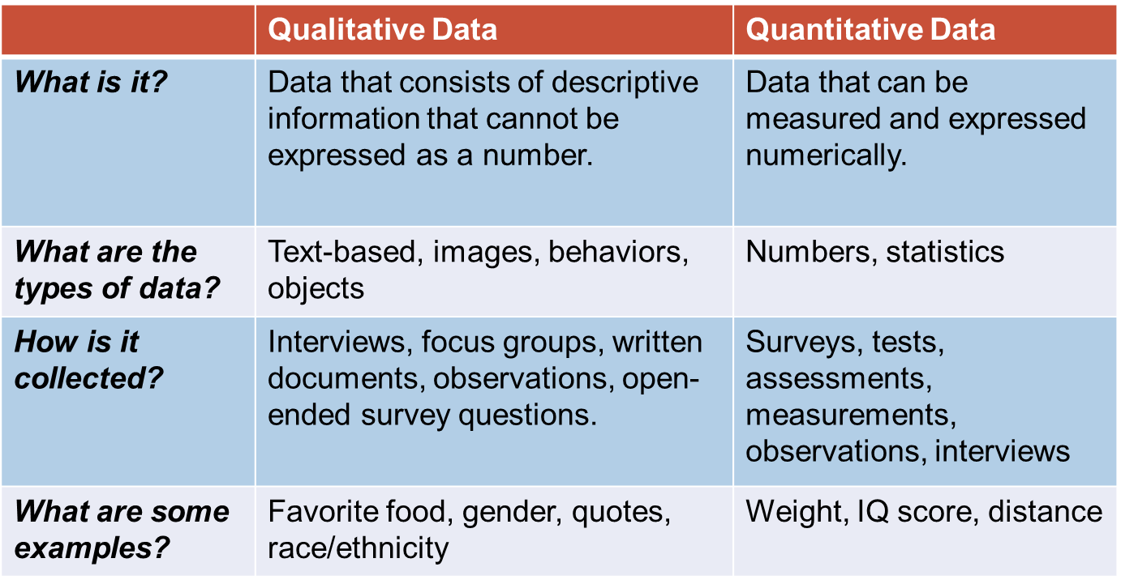
Data Types
Notes:
Now, I’d like to spend a little more time discussing types of data and how they are especially relevant to you as a prevention professional.
Go over the chart–
Chat: Why would you want to use both qualitative and quantitative to improve equity?
quantitative, qualitative, or mixed methods
Quantitative Tips. When an article uses quantitative methods, you will see some of the following key words or clues: statistical significance, hypothesis, survey, control, larger number of participants .
Qualitative Tips. When an article uses qualitative methods, you will see some of the following key words or clues: explore, interviews, focus groups, grounded theory, smaller number of participants.
Mixed Methods Tips. Often in the social sciences and public health world, researchers employ more than one method for a well-rounded study. Social scientists, public health practitioners, and educators typically view research not as quantitative or qualitative, but on a continuum from one to the other. Some studies lean more toward quantitative, some more toward qualitative. There are compelling arguments for the view that mixed methods (i.e., the integration of both quantitative and qualitative data and analytical techniques) are essential for solving complex problems that involve policy, vulnerable groups, and research methods that are tailored and culturally appropriate. You may see these tips or clues: data triangulation, mixed method, mixed methodology, multimethod, integrating methods, qualitative, and quantitative.
Gomez, A. (2014). New developments in mixed methods with vulnerable groups. Journal of Mixed Methods Research, 8(3), 317-320.

Slide 19
Collect Data Multiple Ways
Focus Groups
Key Informant Interviews
Observation
Surveys
Service Records
Notes:
-Focus Groups
In a focus group, you engage members on a specific discussion or topic. Focus groups are qualitative in nature and strategically designed with the intent of encouraging members to speak openly. You use a discussion guide to obtain detailed information from participants. It is helpful to work with a trained facilitator and evaluator to effectively conduct the focus group and analyze the data. You can also use an external evaluator (outside your organization) to help elicit full and honest responses from participants.
-Key Informant Interviews
Interviews, also a qualitative method, can be thought of as a conversation with a purpose. If you need more information in your community about the perceptions of key informants (community experts), this is a great way to collect data. The researcher works one on one with the key informant or expert to garner in-depth information on a particular topic.
-Observation
During observation, you watch or participate in the activities of people, places, or conditions where they exist. Observation is also qualitative in nature.
-Surveys
A survey is typically a questionnaire that asks about a community’s needs. You analyze the results and then use the data to guide further action on a problem. You collect mostly quantitative data on a survey, but you can include a few open-ended responses to collect qualitative data.
-Service Records
You can also collect data on access to services, depending on the problem you are exploring. For example, if you are starting a new syringe exchange program, you will want to collect data on who (demographics such as race, age, gender, education level, etc.) is accessing the program, where, when, and how often. This method is mostly quantitative in nature.
Thick vs. Thin Descriptions
Thick description is a social sciences qualitative research technique that gives detailed descriptions and interpretations of situations observed by a researcher. Thick description involves writing detailed narratives or ‘vignettes’ explaining situations and their background ‘context’. It’s not enough to note that a participant paused, or winked. These observations need to be described and analyzed in the context of culture, the history between participants, etc. It involves providing the background information necessary for understanding the relevance, meanings and intentions that underpin social interactions.

Slide 20
Acquiring Existing Data
How was the data collected (method, format, etc.)?
What was the original intent of the data?
Is the data anonymous? Are there permissions or confidentiality concerns?
Notes:
Poll: How many of you have had to request data from an existing source at some point in your work? Chat Q: What were some of the challenges with the data in terms of equity and social justice?
Prevention professionals often work with existing data. When you work with existing data, you do not directly collect the data yourself. However, it can be just as complicated to work with existing data in other ways. Even if you acquire only secondary data, or data someone else collected, it is important to be aware of the primary data collectors’ motivations—why they wanted the data and how they collected them—before you plan and conduct your analysis.
You will need to know information about how the data was collected, the intent of the data, the steps to request data, and how to respect the data confidentiality concerns of other organizations.
Using existing data is usually more cost-effective, but it does involve a certain level of expertise in negotiating with other organizations, as well as some statistical expertise to analyze the data for the issue you are addressing.
*Be aware that many Federal datasets are not disaggregated by race, ethnicity, gender, disability, income, veteran status, or other key demographic variables. This lack of data has cascading effects and impedes efforts to measure and advance equity.*

Slide 21
Analyzing Data with an Equity Lens
“Human beings encode our values, beliefs, and biases into these analytic tools by determining what data is used and for what purpose. The data that institutions choose to use reveal what variables and reporting mechanism are valued most.”¹
¹Capatosto, K. (2017). Foretelling the future: A critical perspective on the use of predictive analytics in child welfare. Kirwin Institute Research Report. Kirwin Institute for the Study of Race and Ethnicity, Ohio State University.
Notes:
Photo: https://pngtree.com/freepng/business-woman-working-on-computer-and-analyzing-data-charts_5500251.html

Slide 22
Questions to Ask
Process
Outcome
Am I being systematic?
Can it be effectively communicated to stakeholders?
Does it have impact?
Does it affect the quality of a program or strategy?
Reflect on bias, root causes, power
Notes:
As you go through the steps of data analysis, ask yourself :
As you analyze data . . .
ASK
Am I being systematic? Make sure you are documenting your analysis procedures so that someone can else can replicate the procedures. From the beginning, make a plan for how you will analyze the data. Is this useful? Think about how others can utilize the results. Use analysis procedures that will have practical application for stakeholders.
Does it have impact? Consider how findings may influence public policy or programs. The way you report results can have both positive and negative impacts on programs.
Does it affect the quality of a program or strategy? Assess how results might influence the quality of public health or prevention programming—what improvements might be needed?
Can it be effectively communicated to stakeholders? Examine how you might communicate the data analysis methods and results to stakeholders in advance to help guide your decisions.
With these questions in mind, you can begin your data analysis process!

Slide 23
Analysis Options for Equity and Justice
This Photo by Unknown Author is licensed under CC BY-SA
Notes:
Ratio
Proportion—mention percentages are proportions
Rates
Epidemiology uses rates to standardize data in order to be able to compare data across populations that are different sizes. A rate is a measure of the frequency with which a health event occurs in a defined population over a period of time .
For example, if a town with a population of 30,000 has 500 arrests in a given year for driving under the influence (DUIs), you can divide 500 by 30,000 to get a rate of .017 arrests per person per year. To make the rate easier to understand, you can multiply by 1,000 and say that the rate of DUIs for the town is 17 per 1,000 people per year

Slide 24
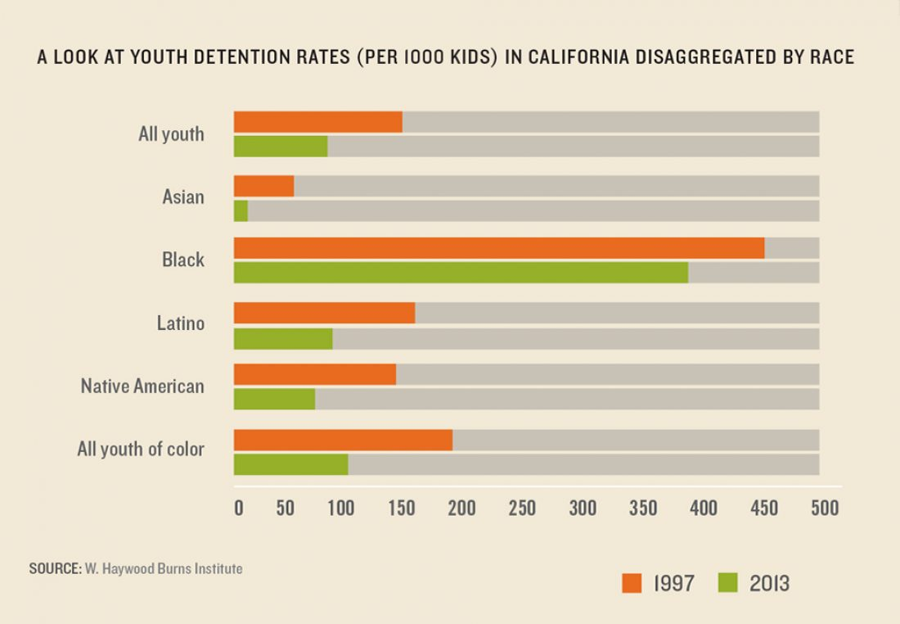
Disaggregation: Analysis and Interpretation
¹Annie E. Casey Foundation (2020). Why Disaggregating Data by Race is Important for Racial Equity. https://www.aecf.org/blog/taking-data-apart-why-a-data-driven-approach-matters-to-race-equity
Notes:
Data are facts used as a basis for reasoning, discussion, or calculation.
Raw data is the base level of information gathered before applying any analysis or interpretation.
With the right skills, raw data can be analyzed and interpreted to help make the information meaningful.
The analysis and interpretation then becomes information that can be used to make better-informed decisions about public or behavioral health issues that are useful to the communities you serve.
Explain graph- If you just look at all youth in 2013—looks like around 100/1,000 had detention, but then when you disaggregate by race you see that Black people had a rate of almost 400 per 1,000 people. Additionally, within people of color, the rate looks similar to all youth, but when you disaggregate youth of color you see Black youth are most at risk.

Slide 25
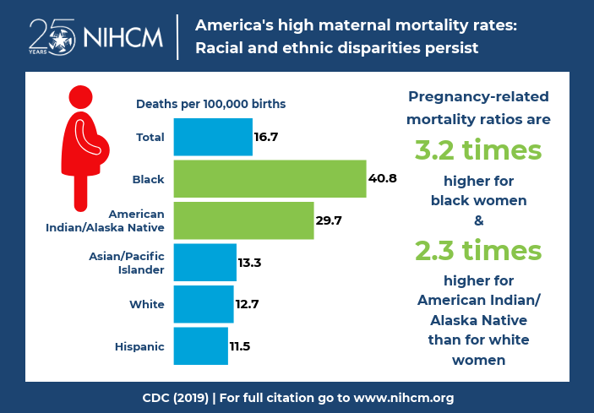
Communicating Data Through an Equity Lens
What equity principles are used in the infographic?
Notes:
“Using data to support a larger narrative intended to communicate some message to a particular audience.”
Chat: What stands out to you on this graphic? What makes it easier to see the main points? What is the story behind this infographic just at a glance? How does this infographic use equity principles?

Slide 26
Telling Your Data Story using Principles of Data Equity and Justice
Stakeholder communication styles, needs, characteristics, and values
Notes:
Now that you have explored your data, analyzed it, and interpreted it, you can begin to share your findings. You might find this to be the most challenging part of becoming data literate, but also the most meaningful. You will learn how to disseminate evidence-based information to make positive change in the community. You need to think critically, not just about the data itself, but about the stakeholders who will be using it—their communication styles, characteristics, needs, and values. Learning how to promote and communicate your findings is an art, as well as a science. If you can master this skill, you will be a powerful asset to your community. You are about to gain some higher-level skills on your data citizen journey, but it is a realistic goal with the tips and tools you will cover in this chapter. Stories are powerful, and when you tell a story using data, that is extremely powerful! Although you can think of communicating results as sharing a story, remember that the story is based on facts and science.
For data citizens to be effective storytellers, your communication of the results must be:
• Intentional.
• Purposeful.
• Visually pleasing.
• Independently interpretable.
The phrase “data storytelling” has been associated with many things—data visualizations, infographics, dashboards, data presentations, and so on. Too often data storytelling is interpreted as just visualizing data effectively, however, it is much more than just creating visually-appealing data charts. Data storytelling is a structured approach for communicating data insights, and it involves a combination of three key elements: data, visuals, and narrative.
When you combine the right visuals and narrative with the right data, you have a data story that can influence and drive change.
Memorability: A study by Stanford professor Chip Heath (Made to Stick author) found 63% could remember stories, but only 5% could remember a single statistic. While 2.5 statistics were used on average in the exercise and only 10% of the participants incorporated a story, the stories are what caught people’s attention.

Slide 27
This video provides a quick overview of recommendations to help you understand how to present data through a more diverse, equitable, and inclusive lens.
Presenting Data with an Equity Lens
https://www.tableau.com/foundation/data-equity/do-no-harm?_ga=2.192065774.597531287.1639505145-1962008467.1639505144
Notes:
If possible, watch video live.
This video provides a quick overview of recommendations to help you understand how to present data through a more diverse, equitable, and inclusive lens.
https://www.tableau.com/foundation/data-equity/do-no-harm?_ga=2.192065774.597531287.1639505145-1962008467.1639505144
Chat: What stands out to you after watching the video?
An example of contextualizing the data would be good here. An example is black women have the highest rate of maternal mortality. Black immigrant women have the same rate of maternal mortality as white women. given the poor access to equitable healthcare black women have the highest rate of maternal mortality is a more accurate way to share this data. I provides the why and does not blame black women for this circumstance.

Slide 28
Let’s hear from you. What would you do to improve data equity and justice?
You are given data with overall frequencies for poverty and substance use in your community and asked to implement a program with limited funding.
You are handed a bar chart displaying prescription drug overdoses by race/ethnicity that has all people of color listed last in a graph.
You are presenting on data equity and a participant says there is no diversity in their community.
You are part of a diverse workgroup designing a community survey, but a new administrator rewrites the survey without consulting the group.
Notes:
Discuss scenarios and some approaches in the chat

Slide 29
A Call to Action
“Acknowledging history, harm, and the potentially negative implications of data integration for groups marginalized by inequitable systems is a key first step, but it is only a first step. To go beyond this, we must center the voices, stories, expertise, and knowledge of these communities in decision making, and take collective action with shared power to improve outcomes and harness data for social good.”
--Actionable Intelligence for Social Policy
Notes:
We call for the inclusion of community voices and power sharing at every stage of data design, use, and implementation. We call for relationship building among those represented in the data and those using the data. Without a deliberate effort to address structural racism, institutional racism, and unrecognized bias, data integration will inevitably reproduce and exacerbate existing harm. To avoid this, we must embed questions of racial equity throughout the data life cycle:
In planning
In data collection
In data access
In algorithms/use of statistical tools
In data analysis
In reporting and dissemination

Slide 30
Wrapping up
What is one way you will incorporate data equity and justice into your prevention work?
What is one thing you can do to build your capacity with data equity and justice in the next 30 days?
Notes:
Building your skills in these areas will help you become a data-driven and informed prevention professional using both data equity and data justice as a guide, and help you effectively implement the SPF in your communities and effectively focus efforts and honor the individuals and communities we serve. The benefits you bring will be to your community and the profession as a whole. These skills help bring about changes in policy for healthier communities. When we take data-driven approaches that have data equity and justice as their foundation, outcomes are more likely to be achieved, and these help the public and policymakers see the “data stories” of our communities. Build on your strengths as an advocate, and continue learning and practicing with data ethics as your guide.
Many Federal datasets are not disaggregated by race, ethnicity, gender, disability, income, veteran status, or other key demographic variables. This lack of data has cascading effects and impedes efforts to measure and advance equity.
Chat: Take aways
What is one way you will incorporate data equity and justice into your prevention work after today’s presentation?
What is one thing you can do to build your capacity with data equity and justice in the next 30 days? Who do you need to reach out to?

Slide 31
What questions do you have for us?

Slide 32
Resources
Approaches for Diverse, Equitable, and Inclusive Evaluation
https://bellwethereducation.org/sites/default/files/Bellwether_ApproachesToDEIEvaluation_Final.pdf
A Toolkit for Centering Racial Equity Throughout Data Integration
https://aisp.upenn.edu/wp-content/uploads/2020/08/AISP-Toolkit_5.27.20.pdf
Engaging the Families of Transgender and Gender Diverse Children
https://www.lgbtqiahealtheducation.org/wp-content/uploads/2021/09/Engaging-the-Families-of-Transgender-and-Gender-Diverse-Children-9.10.21.pdf
How to Embed a Racial and Ethnic Equity Perspective in Research: Practical Guidance for the Research Process
https://www.childtrends.org/wp-content/uploads/2019/09/RacialEthnicEquityPerspective_ChildTrends_October2019.pdf
LGBTQ-Inclusive Data Collection: A Lifesaving Imperative
https://assets2.hrc.org/files/assets/resources/HRC-LGBTQ-DataCollection-Report.pdf
Principles for Advancing Equitable Data Practice
https://www.urban.org/sites/default/files/publication/102346/principles-for-advancing-equitable-data-practice.pdf
Why Am I Always Being Researched? A Guidebook for Community Organizations, Researchers, and Funders to Help Us Get From Insufficient Understanding to More Authentic Truth
https://chicagobeyond.org/wp-content/uploads/2019/05/ChicagoBeyond_2019Guidebook.pdf

Slide 33
Thank You!
For questions regarding this presentation:
Nicole Schoenborn
Evaluator
South Southwest PTTC
nicoled@ou.edu
405-826-5648

Slide 34
CONNECT WITH US
PTTCnetwork.org
PTTC Virtual Booth
PTTC News

