Slide 1
The Center of Excellence for Integrated Health Solutions March 12th, 2020

Slide 2
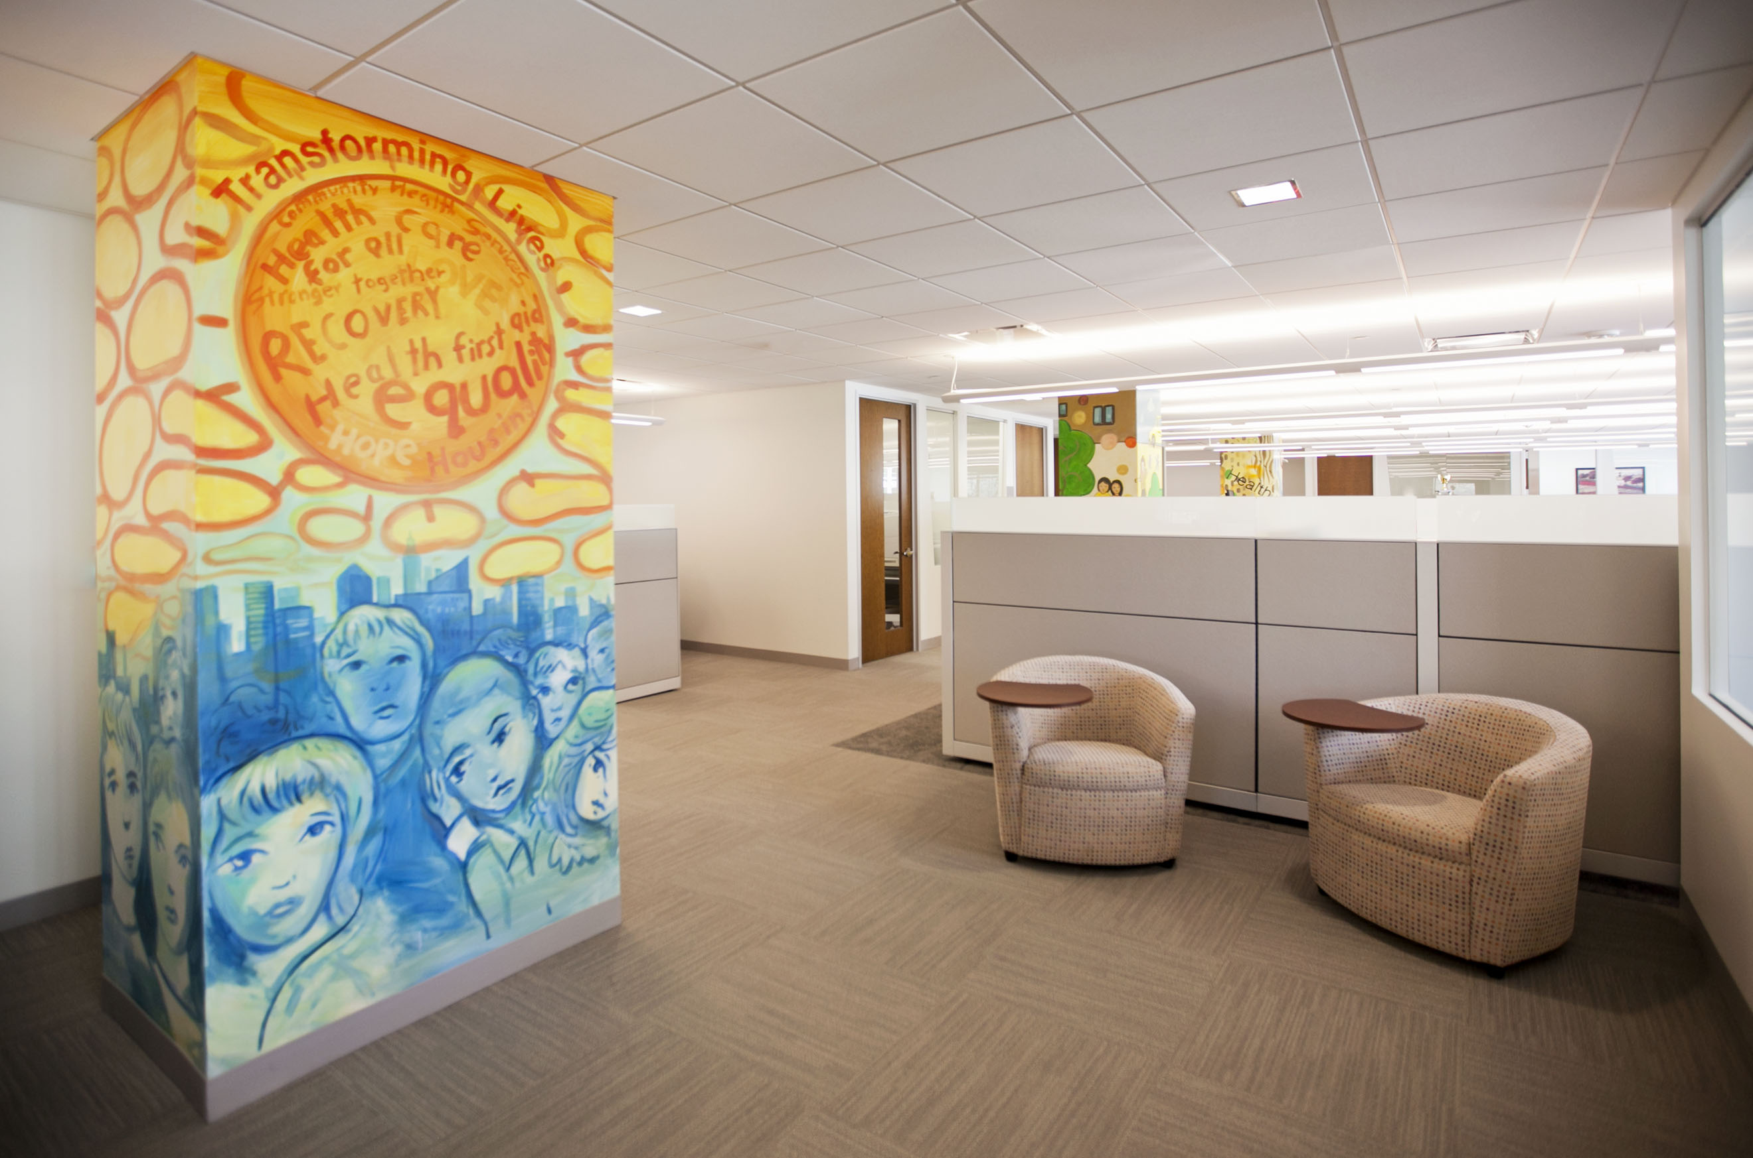
National Council for Behavioral Health
3300+ healthcare organizations serving over 10 million adults, children, and families living with mental illnesses and
addictions.
Advocacy
Education
Technical Assistance

Slide 3
Background & Context
Jointly Funded by SAMHSA & HRSA
Now Center of Excellence for Integrated Health Solutions (CoE) is funded by SAMHSA through the National Council
National Center for Behavioral Health Technical Assistance (BHTA) is funded by HRSA through the John Snow Institute

Slide 4
Our Purpose:
To advance the implementation of high quality, evidence-based treatment for individuals with co-occurring physical and mental health conditions, including substance use disorders.
Provide training, resources, and technical assistance to health practitioners and other stakeholders addressing the needs of individuals with co-occurring physical and mental health conditions, including substance use disorders.

Slide 5
Our Partners
Multicultural Development Institute, Inc.

Slide 6
Impact to Date
TA Provided – Target vs. Actual
Average Participant Satisfaction (all activities)

Slide 7
Center of Excellence Activities
Technical Assistance & Coaching
In-Person Trainings
Online Trainings (Relias)
Webinars
Learning Communities & ECHOs
Resources & Tools
Learn more on our website: https://www.thenationalcouncil.org/integrated-health-coe/

Slide 8
Current Learning Communities (LC) and ECHOs
Topic | Lead
Integration with Federally Qualified Health Centers (LC) | NASADAD
Collaborative Care ECHO | John Kern, MD
Integration for Addiction ECHO – Addressing America’s Silent Killers | The Weitzman Institute
An Integrative Approach to Addressing Diabetes (LC) | PCDC

Slide 9
Recent CoE Activity Highlights
Developing an “ECHO Hub” at the National Council
CoE team participated in recent training - University of New Mexico’s ECHO Immersion Training
CCBHC Technical Assistance
CoE supports CCBHC T/TA for those who have recently applied for expansion grants, and for current CCBHCs looking to improve & scale efforts
Resources under development
Report – Revised Levels of Integration, developed by CoE’s Advisory Council
Environmental Scan of State Assessment Tools, developed by NRI
Oral and Behavioral Health Integration Environmental Scan
Integration Edge Newsletter Vol. 1

Slide 10
COVID-19 Related Work
Weekly Learning Calls with members on the following topic areas:
Self-Care and Stress Management
Finance and Operations
Substance Use Disorder Services
Child, Youth, and Families
Residential Treatment Services
Telehealth and Telemedicine
Listening Sessions with partner, PCDC
Sharing the latest information, resources, and learning opportunities on National Council website: https://www.thenationalcouncil.org/covid19/

Slide 11
Upcoming Webinars & Events
Webinar – No Two People Are the Same: Respecting Cultural Diversity when Delivering Healthcare
April 22, 2:00-3:00pm ET
Register from our website here: https://zoom.us/webinar/register/4315826397931/WN_zdq9L4lyR_qdff4H4rFRvw
Learning Communities and ECHOs – Learn more on our website here: https://www.thenationalcouncil.org/integrated-health-coe/learning-collaboratives/
Relias Online Trainings – Learn more on our website here: https://www.thenationalcouncil.org/integrated-health-coe/training-events/
Request Technical Assistance - https://www.thenationalcouncil.org/integrated-health-coe/request-assistance/

Slide 12
Questions for you:
How can we foster alignment in our work with other TTCs?
Are there any opportunities now for collaboration and cross-promotion?

Slide 13
Questions
integration@thenationalcouncil.org
https://www.thenationalcouncil.org/integrated-health-coe/

