Slide 1

Substance Abuse and Mental Health Services Administration | Office of Behavioral Health Equity
National Network to Eliminate Disparities in Behavioral Health
NNED Overview
June 24, 2020
Presentation for the Technology Transfer Centers
1
Notes:
Rachele

Slide 2


WELCOME & INTRODUCTIONS – ABOUT THE NNED
Rachele Espiritu
Alina Taniuchi
Founding Partner, Change Matrix
Director, NNED National Facilitation Center
Change Specialist, Change Matrix
Communications Manager, NNED National Facilitation Center
2
Notes:
Rachele/Alina

Slide 3

AGENDA FOR TODAY
NNED Overview & Regional Approach
Dialogue
Q & A
Engagement Opportunities
Dive into the NNED Website
Introductions
3
Notes:
Rachele

Slide 4
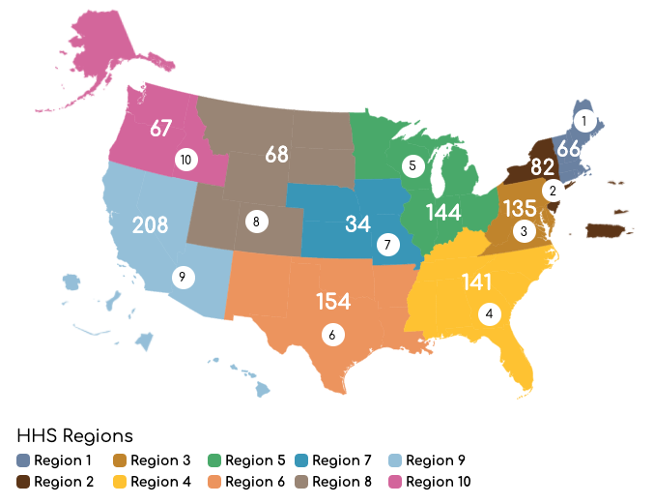
ABOUT THE NNED
National Network to Eliminate Disparities in Behavioral Health
A network of over 4,300 individuals, including more than 1,100 community-based organizations striving for behavioral health equity for for all individuals, families, and communities.
4
Notes:
Rachele

Slide 5




ABOUT THE NNED – WHAT WE DO
PARTNER
CENTRAL
https://nned.net
Interactive website with relevant hot topics, news items, calendar events, funding opportunities, professional development, discussion forums, interactive tools, and other resources
5
Notes:
Alina

Slide 6

ABOUT THE NNED – WHAT WE DO
PARTNER
CENTRAL
https://nned.net
E-newsletter with relevant news, partnership opportunities, and announcements of timely federal and foundation funding
5
Notes:
Rachele

Slide 7
ABOUT THE NNED – WHAT WE DO
PARTNER
CENTRAL
https://nned.net
Collaborative space on NNED website to share resources and intervention efforts to improve the delivery of behavioral health interventions in diverse populations, and learn about resources and innovative community efforts
5
Notes:
Alina

Slide 8
ABOUT THE NNED – WHAT WE DO
PARTNER
CENTRAL
https://nned.net
Professional development opportunity for NNED members to receive training in evidence-supported and culturally appropriate mental illness and substance use prevention and treatment practices and to support practice implementation
5
Notes:
Rachele

Slide 9
ABOUT THE NNED – WHAT WE DO
PARTNER
CENTRAL
https://nned.net
Interactive searchable database of NNED partner organizations, including opportunity to filter and message organization contacts
5
Notes:
Alina

Slide 10
NNED FY 2020 REGIONAL STRATEGIES
Identify and recruit additional community-based organizations and agencies across the country to improve NNED Partner Organization representation by region, particularly in regions with proportionally lower membership
Increase website event and resource postings that are region-specific and coded accordingly to allow opportunity to connect locally. Social media strategies will also highlight regional content to complement this shift.
Engage SAMHSA Regional Administrators to draw upon regionally-based expertise and contribute guidance, ensuring NNED resources effectively support the needs of communities.
6
Notes:
Rachele

Slide 11
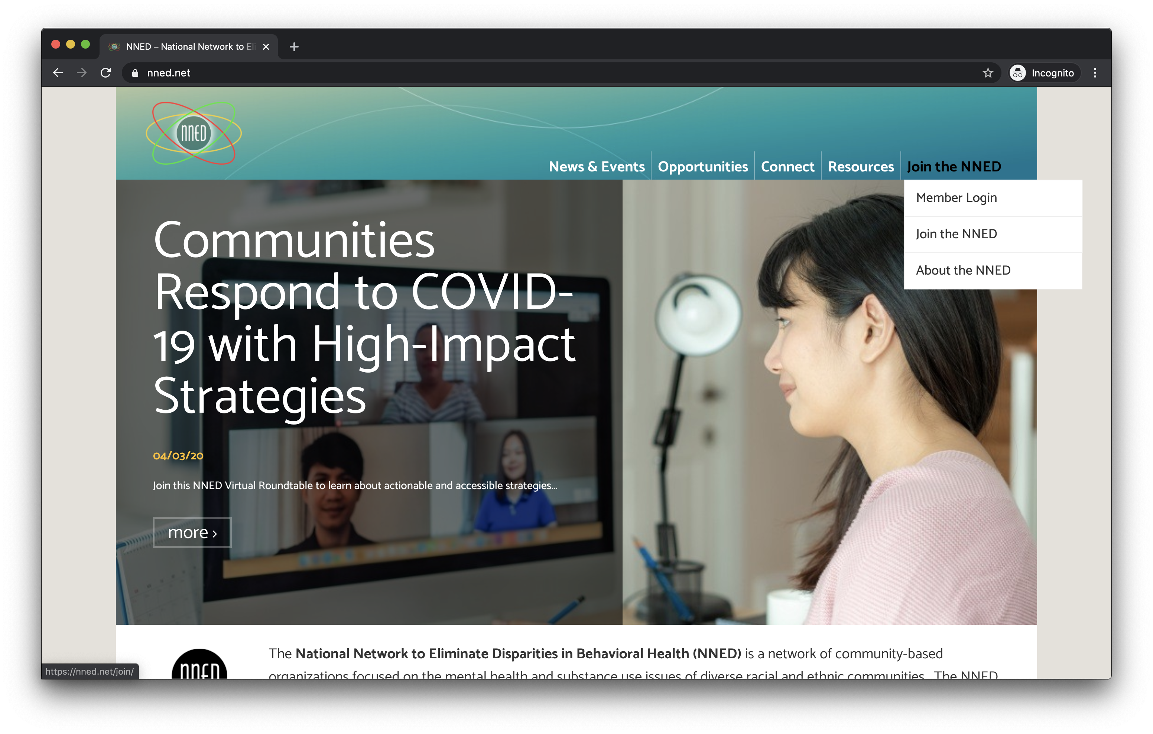
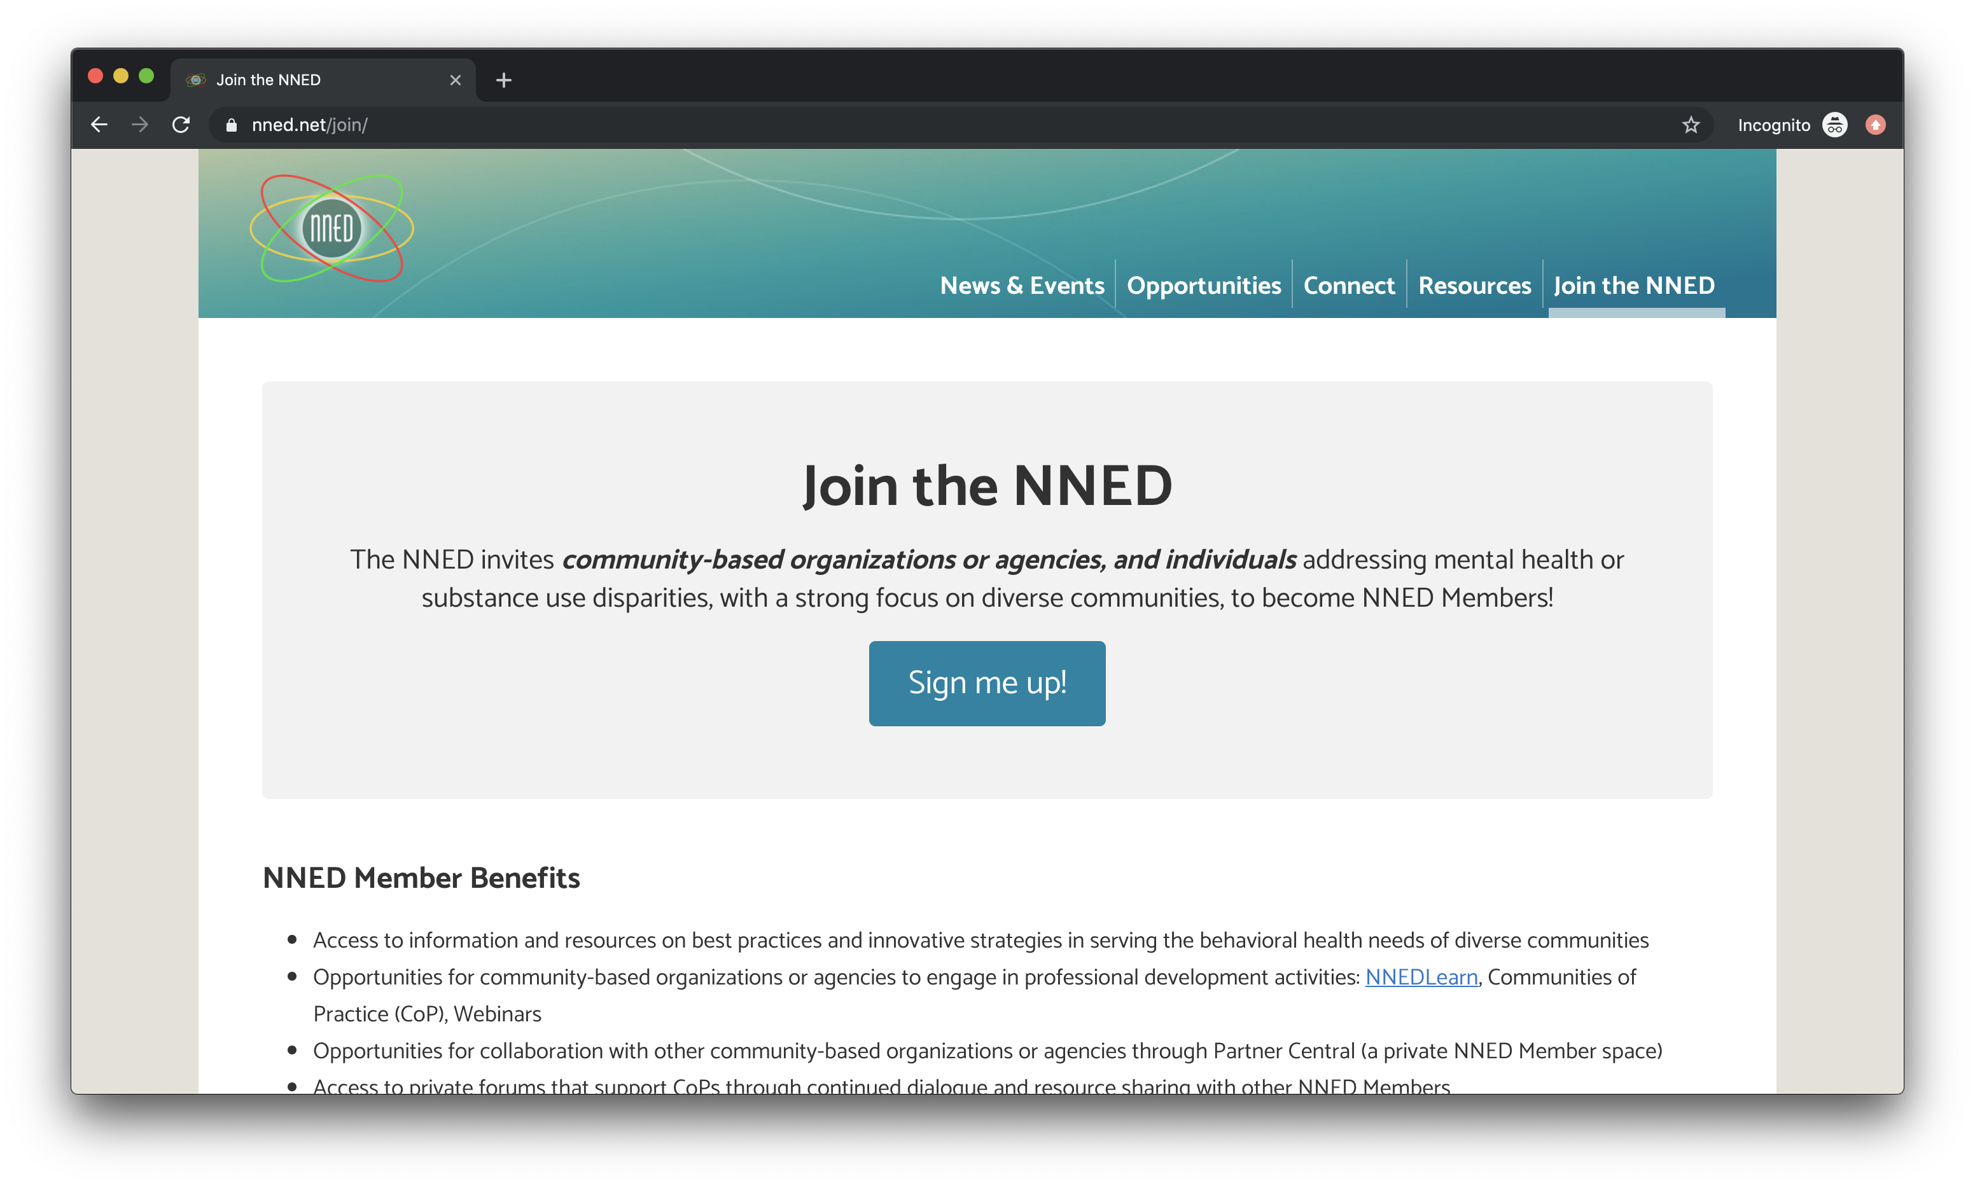
1
NNED WEBSITE – BECOME A MEMBER
Join the Network!
https://nned.net/join
2
7
Notes:
Alina

Slide 12
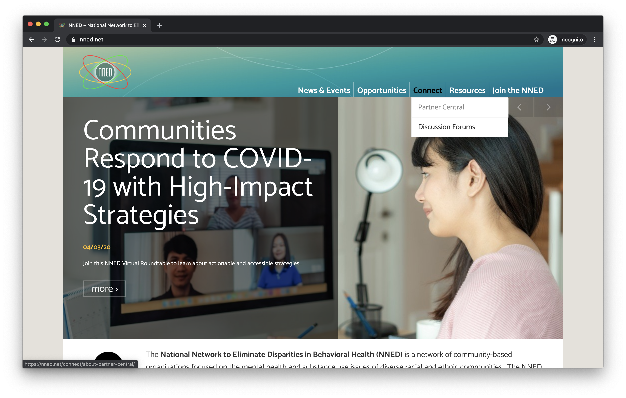
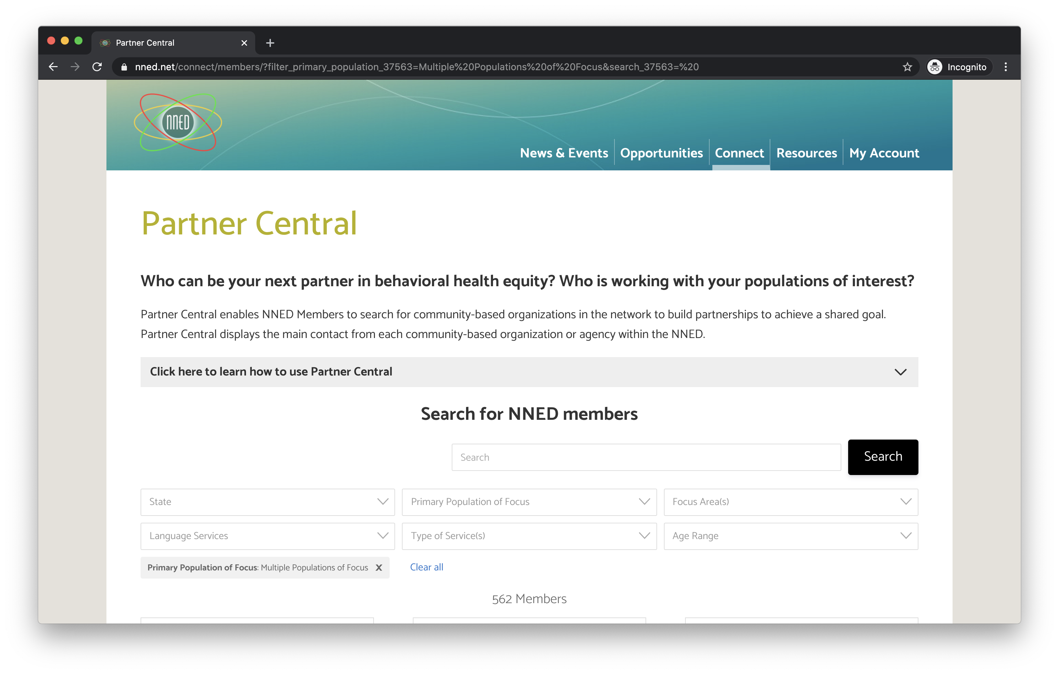
1
NNED WEBSITE – PARTNER CENTRAL
Find Community-based Organizations in Partner Central*
https://nned.net/members
2
*NOTE: You must be a logged-in NNED member to access Partner Central
8
Notes:
Alina

Slide 13
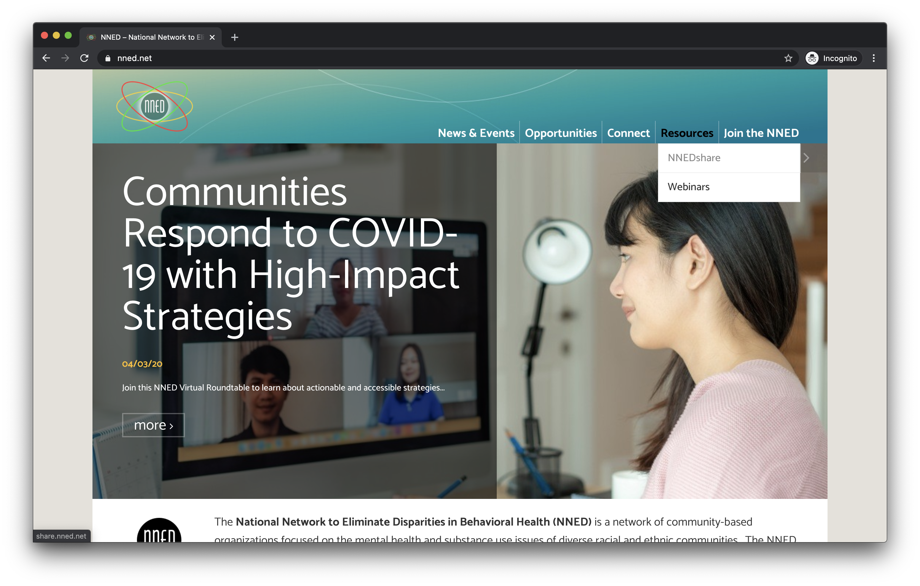
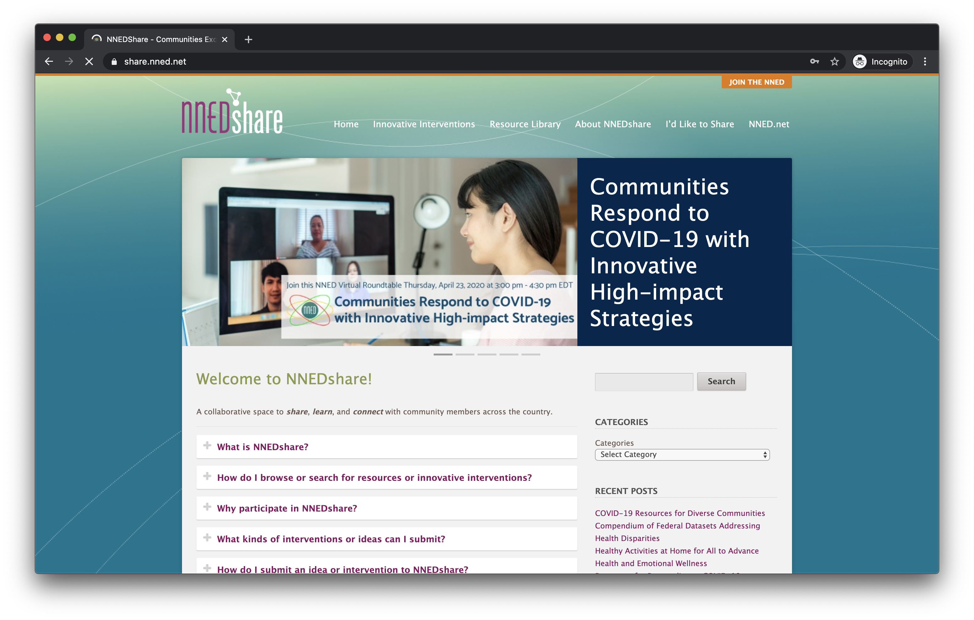
1
NNED WEBSITE – NNEDSHARE
Explore NNEDshare!
https://share.nned.net
2
9
Notes:
Alina

Slide 14

NNED UPDATES AND ENGAGEMENT OPPORTUNITIES
NNED Virtual Roundtable:
July 16th 3:00-4:30pm EDT
Information Identification and Dissemination
Partner Central
NNEDshare
10
Notes:
Rachele

Slide 15


FINAL THOUGHTS
KEEP IN TOUCH!
Share resources with us: Email resources@nned.net
Join the NNED: Visit https://nned.net/join/
Questions: Email respiritu@changematrix.org
11

