Slide 1
Making It Stick
A Practical Approach
to Dissemination and Implementation
Internal Learning Community

Slide 3
Welcome and Introductions
Please introduce yourself in the chat:
Name
Pronouns, if comfortable
Center and Network
Location
Accomplishments under 18 (personal or academic)? Dream job?

Slide 4
Recap from Part 1: Implementation Stages
What are the steps and stages to implement a new practice?
Stage models
EPIS
Fixsen & Blase
Key aspects:
Multiple stages to every change
Variable timelines
Not necessarily linear
May not have a definite beginning or end

Slide 5
Part 2 - Roll Out: How do we decide what to do?
Four types of D&I frameworks and concepts can help us make our work more effective
Implementation stages (session 1)
Engagement and context for implementation (barriers and facilitators) (session 2)
Implementation strategies (TA activities; session 2)
Evaluation of implementation (session 3)
Nilsen, 2015

Slide 6
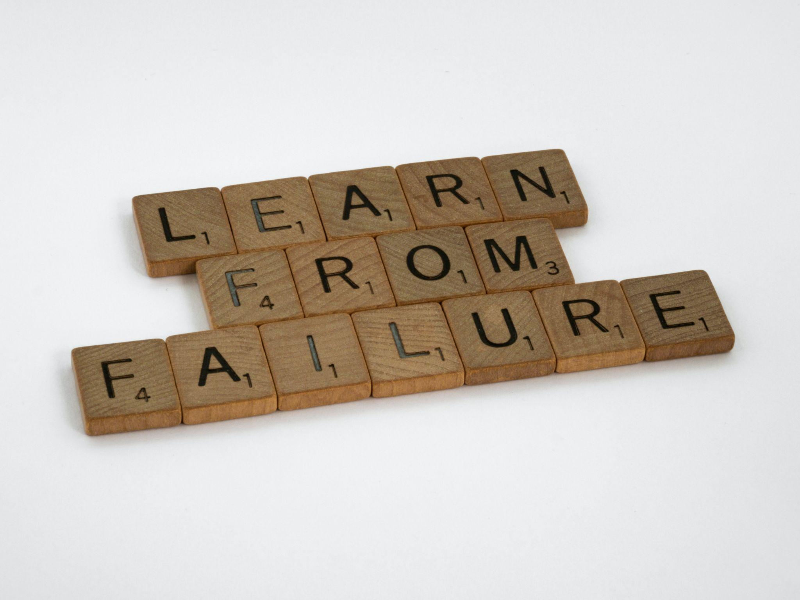
What Can Go Wrong?
Why am I here?
This won’t work!
What timing!
Who’s left?
We need what?
Photo by Brett Jordan: https://www.pexels.com/photo/wood-typography-photography-blur-7952673/

Slide 7
Engagement Strategies at the Organizational Level
Start with TA through an Implementation Team to plan through all stages (ideal)
Require an Organizational Application
Conduct an Organizational Readiness Assessment
Examine and Align Policies in Advance
Examine and Reduce Barriers in Advance
Require Financial Commitment

Slide 8
Engagement Strategies at the Individual Level
Application process (strategic in selection)
Require participation in teams
Provide pre-work to build readiness
Assess participant’s readiness and adapt the training to it
Enhance commitment intentionally
Create staged training to funnel participants

Slide 9
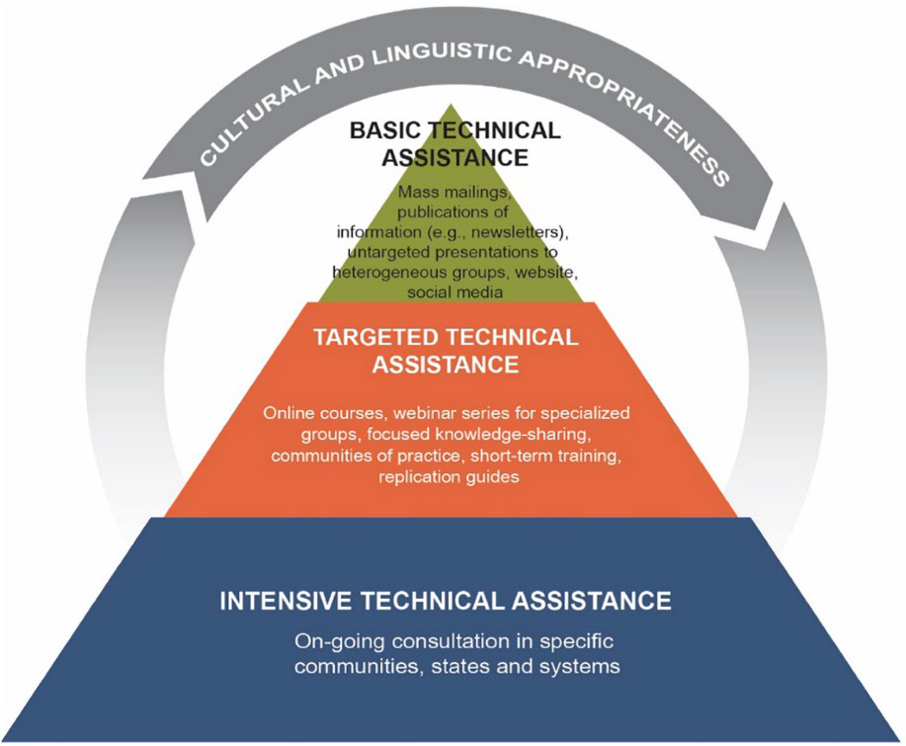
Stress Management and Resilience Training
Tier 1 Webinars
Tier 2 Workshops
Application for Tier 3

Slide 10
Intensive TA Project Example
Northeast & Caribbean MHTTC’s Motivational Interviewing project
Engagement and recruitment of audience
Sent out a call for applications
Reviewed applications/set criteria
Met via phone for initial discussion with administrators/agency leads
Assessed readiness in person/zoom (admins and staff)
Some examples of readiness questions

Slide 11
Reflection - Breakout Rooms
Decide on volunteer leader/timekeeper and report out person.
Considering how the MI Project engaged their audience…
What does your TTC do similarly and/or differently when engaging an ITA audience?
Is there one thing in your engagement toolbox that is a must have? Why?

Slide 12
Report Out
In the chat, list your “must have” engagement tool
1 or 2 report out people unmute and share

Slide 13
Implementation cannot be separated from context
Systems (outer settings)
At the simplest level, we can think of three levels of context:
Individuals
Organizations
Systems
Organizations (inner settings)
Individuals (workforce)

Slide 14
Implementation science can be applied to the fictional world of

Slide 15
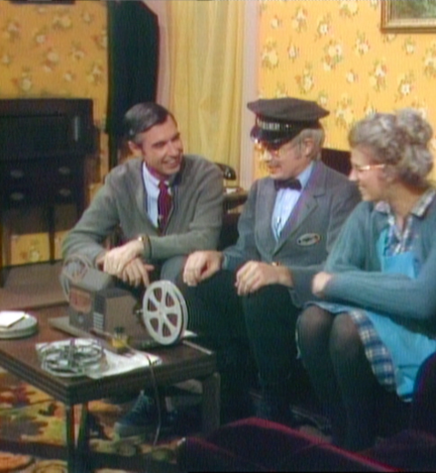
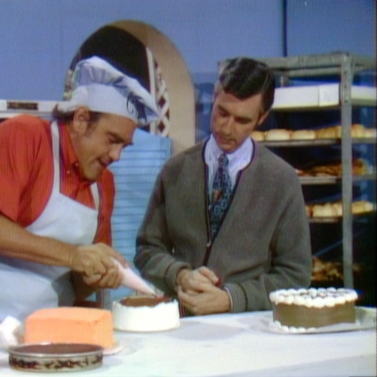
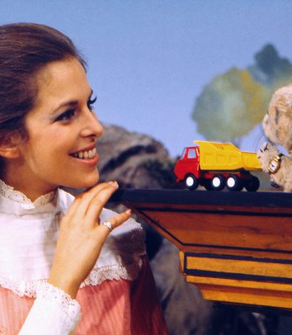
Individuals
At the individual level, Mr. Rogers is surrounded by friendly neighbors who are committed to helping children learn and gain positive experiences

Slide 16
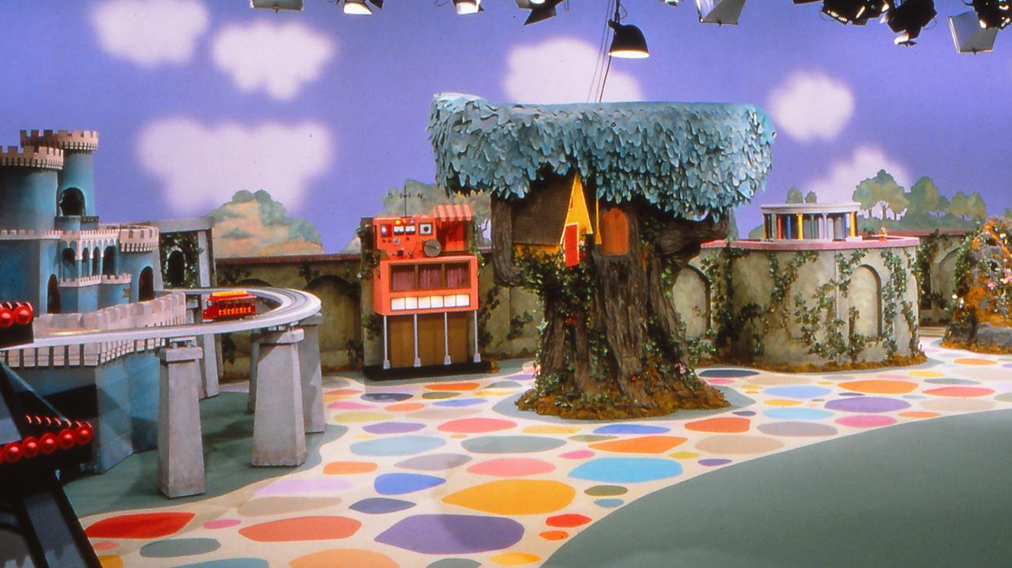
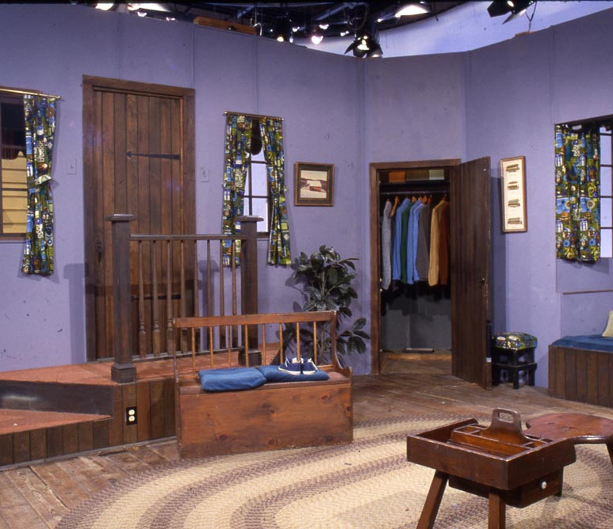
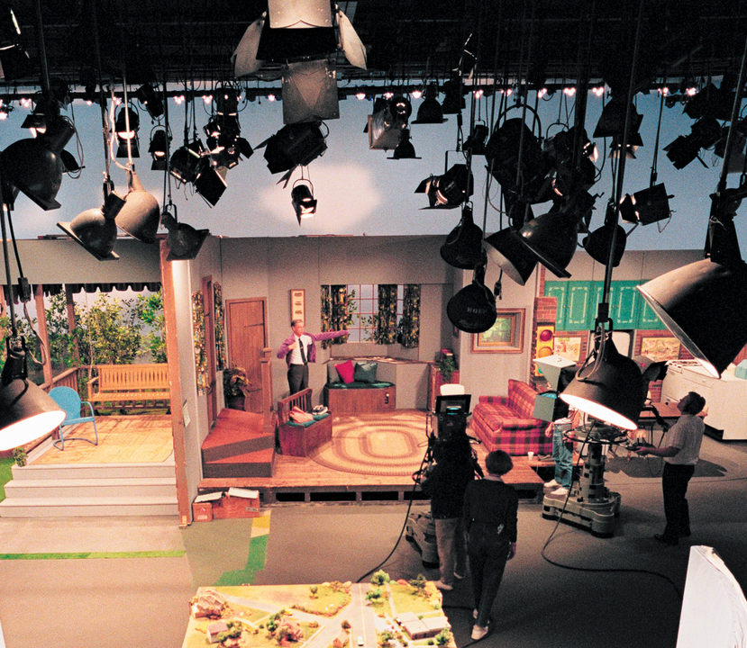
The individuals within Mr. Rogers neighborhood are embedded within a cozy house that includes a creative world of make-believe that is filled with numerous resources including puppets, props, and educational materials
Inner Settings

Slide 17
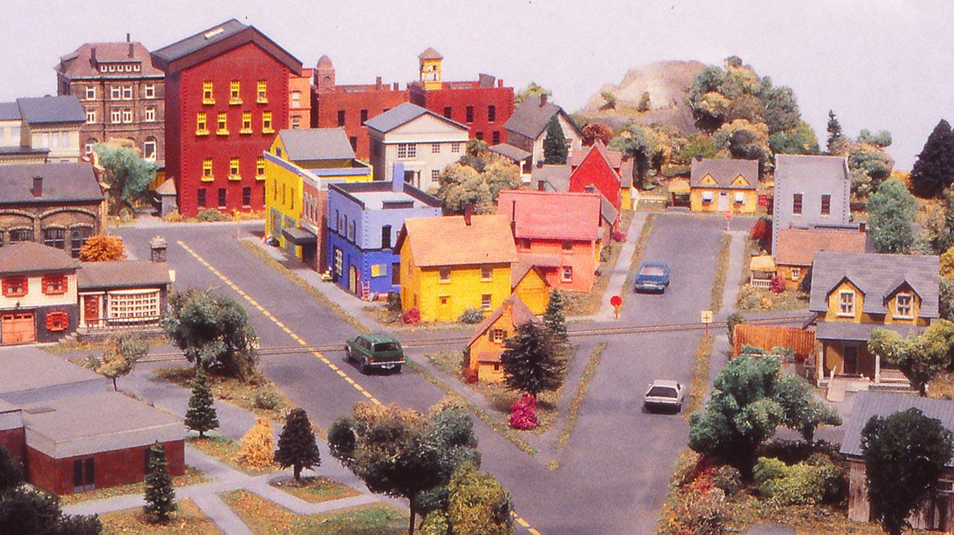
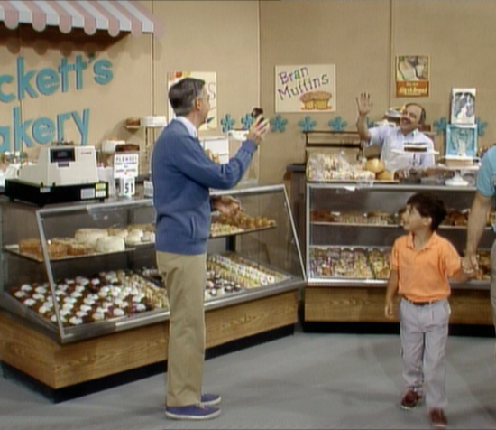
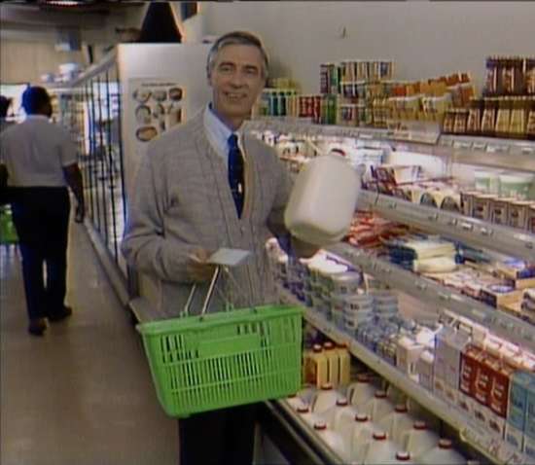
Outer Settings
Mr. Rogers’ house is embedded within a resource-filled community that includes specialty shops, museums, a library, a post-office, and a bakery, among many other community assets. The community appears safe and provides a supportive environment that helps enable Mr. Rogers’ efforts to support young people.

Slide 18
How can the Mr. Rogers analogy apply to TTCs?
Individuals:
These are members of the workforce
The people and teams that we train and support
Inner settings:
These are the organizations and agencies in which participants in our trainings work
These settings have their own cultures, leadership styles, resources, and readiness for change
Outer settings:
These are the systems in which our participants’ workplaces are embedded
They include financing structures, policies, public attitudes, etc.

Slide 19
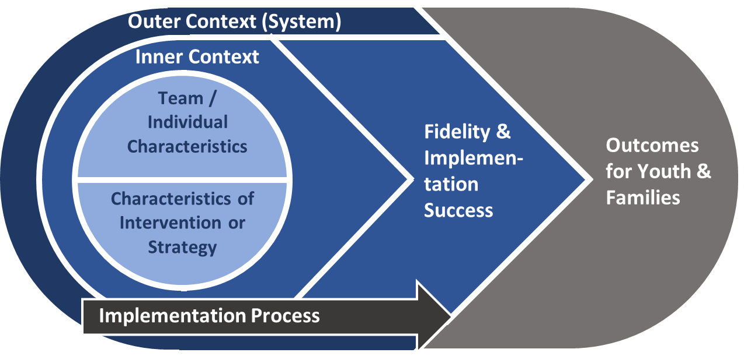
Recent models of implementation science provide a common language to describe these contexts
The Consolidated Framework for Implementation Research (CFIR; Damschroder et al., 2009)
Graphic adapted from Smith, Ashok, Dy, Wines, & Teixeira-Poit, 2014

Slide 20
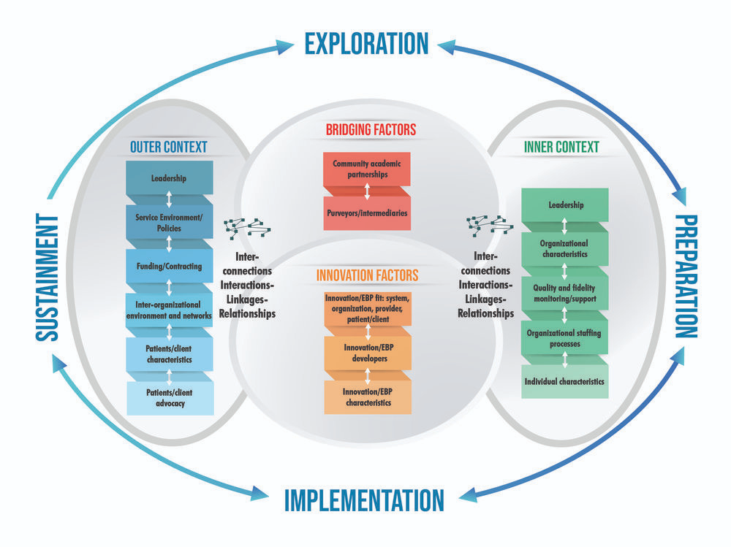
The EPIS model also underscores the importance of context

Slide 21
These contextual considerations should be integrated into our TTC work
Most of our work focuses at the individual level
Workforce development efforts focused on knowledge gains and skill development
Considering context can help promote behavior change and implementation outcomes
Inner and outer settings, intervention characteristics, and implementation processes all influence individual practitioner behavior

Slide 22
Implementation science models can help us identify barriers that we address through training and TA
Examples of system-level barriers:
Examples of organization-level barriers:
Examples of individual-level barriers:
Financing constraints
Mandates
Unsupportive community culture and/or values
Lack of organizational resources
Unsupportive leadership
Organizational culture that is resistant to change
Lack of knowledge and/or skills
Resistance to change

Slide 23
These models also can help us target facilitators that support implementation
Examples of system-level facilitators:
Examples of organization-level facilitators:
Examples of individual-level facilitators:
Available funding
Political priority
Public demand
Innovative organizational culture
Supportive leadership
Organizational resources
Motivated workforce
Skilled practitioners

Slide 24
How can TTCs incorporate context into our work?
Choosing topics
Is implementation realistic in light of barriers and facilitators?
What level of support is needed for successful implementation?
Targeting a particular audience
Practitioners, supervisors, others
Who will benefit most from the training/TA?
Selecting speakers
Who can connect with the target audience?
Designing an evaluation
How can D&I theory and research inform evaluation design?
This Photo by Unknown Author is licensed under CC BY-SA-NC

Slide 25
Intensive TA Project Example
Northeast & Caribbean MHTTC’s Motivational Interviewing project
Barriers and facilitators
Individual Level |  | Organizational Level (inner settings) |  | System Level (outer settings)
Facilitators | Barriers | Facilitators | Barriers | Facilitators | Barriers
-Clinically licensed supervisors -Relatively recent MI training |  | -Administrators interested in implementing all parts of MI into their orgs. -Admins=high level of readiness | -Clinical supervisors and direct service staff=low levels of readiness -Direct service staff turnover |  | -COVID-19 pandemic

Slide 26
Implementation Strategies (TA activities)
The activities, actions, or causal agents for the installation, scale up, scale out, or sustainment of an evidence-based practice
Training and TA “interventions” of an implementation or sustainment endeavor
How do we choose which strategies to offer for a particular implementation project?
Level of TA, stage of implementation, barriers/facilitators
Image from www.gotcredit.com

Slide 27
Categories of Implementation Strategies
Category | Examples
Plan | Conduct local needs assessment; assess for readiness and identify barriers; develop implementation plan; build local consensus; mandate change
Educate | Develop effective educational materials; conduct ongoing training; inform local opinions leaders; prepare patients/consumers to be active participants
Finance | Alter incentives; place on formularies; access new funding; make billing easier
Restructure | Create new clinical teams; change service sites; change physical structure and equipment; change records systems
Manage Quality | Develop and organize quality monitoring systems; audit and feedback; obtain and use patient/consumer/family feedback; provide clinical supervision; conduct cyclical small tests of change (PDSA cycles)
Attend to Policy | Encourage the promotion of programs and practices through accrediting bodies, licensing boards, and legal systems
Powell et al., 2012

Slide 28
How to choose?
Standard practice is imprecise
80%
60%
40%
20%
0%
-20%
-40%
-60%
Absolute effect size
“It seemed like a good idea at the time” (Eccles)
-80%
N =
56 63 46 28 16
1 2 3 4 >4
Number of interventions in treatment group
“Train and Pray”
Approach
“Kitchen Sink” Approach
“One Size Fits All” Approach
“ISLAGIATT”
Approach
Grimshaw et al., 2004; Henggeler et al., 2002; Squires et al., 2014

Slide 29
How to choose?
Tailoring for precision implementation
Identify stage of implementation
Assess context to identify barriers and facilitators that may need to be addressed
Design and select strategies appropriate to stage and barriers/facilitators
Photo by amirali mirhashemian on Unsplash

Slide 30
Selecting Strategies Based on Stage of Implementation
Sustainment:
Continue funding and support
Ongoing training
Ongoing fidelity monitoring
Make refinements
Exploration:
Form an implementation team
Identify the problem
Conduct a needs assessment
Identify potential solutions
Determine program fit
Preparation:
Ensure leadership buy-in
Develop an implementation plan
Educate and train staff/stakeholders
Identify viable funding streams
Change policies and procedures
Implementation:
Verify buy-in
Complete training
Manage expectations
Monitor fidelity to the EBP
Collect and evaluate outcomes

Slide 31
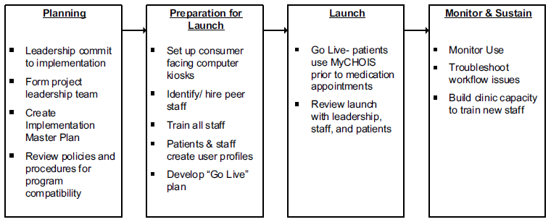
Selecting Strategies Based on Stage of Implementation
Client-Facing Web-Based Shared Decision-Making System in Two Mental Health Clinics
Finnerty et al., 2019

Slide 32
Selecting Strategies Based on Facilitators/Barriers
Identified Barrier | Relevant Implementation Strategy
Lack of knowledge | Interactive education sessions
Perception/reality mismatch | Audit and feedback
Lack of motivation | Incentives/sanctions
Beliefs/attitudes | Peer influence/opinion leaders
Workflow/time | Process redesign

Slide 33
Tailoring Implementation Strategies – How Much is Enough? Do Barriers/Facilitators Matter?
 | Standard | Enhanced
Implementation manual | x | x
Training | x | x
Technical assistance | x | x
External facilitation Gather information Garner regional/local support Identify barriers/facilitators Develop action plans Feedback & link to resources |  | x x x x x
Reengaging Veterans with SMI into Care - 158 facilities
Adaptive implementation trial
How much implementation support is needed?
Does the level of support vary by specific factors?
Sites with more positive organizational culture and climate benefited more from Enhanced package
Kilbourne et al., 2014, 2015; Smith et al., 2018

Slide 34
Reflection - Breakout Rooms
Decide on volunteer leader/timekeeper and report out person.
Individual Level |  | Organizational Level (inner settings) |  | System Level (outer settings)
Facilitators | Barriers | Facilitators | Barriers | Facilitators | Barriers
-Clinically licensed supervisors -Relatively recent MI training |  | -Administrators interested in implementing all parts of MI into their orgs. -Admins=high level of readiness | -Clinical supervisors and direct service staff=low levels of readiness -Direct service staff turnover |  | -COVID-19 pandemic
Considering the barriers and facilitators Joni described in the MI project above… what implementation strategies/TA activities would you use?

Slide 35
Report Out
In the chat, list the implementation strategies you would use
1 or 2 report out people unmute and share

Slide 36
Intensive TA Project Example
Northeast & Caribbean MHTTC’s Motivational Interviewing project
Evaluative and Iterative Strategies
Initial discussions about needs and readiness
Phone and in person
Implementation plan development
Train/educate staff
In person training for direct service and supervisors (one 6-hour training)
Virtual training for administrators (two 1 ½-hour trainings)

Slide 37
Intensive TA Project Example
Interactive assistance
Bi-monthly group coaching calls (each group)
Coaching session for direct service staff (in person; one 3- hour session)
Coaching session for supervisors (in person; one 3-hour session)
Restart/booster after pandemic halt for supervisors and direct service staff (virtual; one 3-hour session)
Final discussions/consultation with each group and org to assist with implementation and sustainment (virtual; one 1-hour session)

Slide 38
Wrap Up and Next Session
Summary: Session 2: Roll Out: How do we decide what to do?
Readiness: How to engage the audience in intensive TA projects; How to assess readiness to adopt and implement;
Context: How to understand the drivers and barriers (context) and readiness for implementation, and how those factors impact your decisions about what TA to provide
Strategies: Deciding which implementation/TA strategies to use
Preview: Session 3: Working Session: How do we put what we’ve learned into practice?
“Evaluation: We can do more than we think!” or “Evaluation: It’s not just for evaluators”
ITA planning: Template for developing TA projects that change practice
June 27, 2022, 12-1:30pm PT

Slide 39
Closing
Plus / Delta questions
What did you like most about today’s session?
What do you suggest we change for next session?

