Slide 1
Part 3: Working Session: How do we put what we’ve learned into practice?
Topics Covered:
Evaluation of implementation - RE-AIM
Putting it all together

Slide 2
Welcome and Introductions
Please introduce yourself in the chat:
Name
Pronouns, if comfortable
Center and Network
Location
Favorite summer treat

Slide 3
Recap of Part 2: How do we decide what to do?
Engaging our audience
Readiness assessment, application processes
Context for implementation
System, organization, and individual levels
Evidence-based implementation strategies
Tailor strategies to stage or context
Systems (outer settings)
Organizations (inner settings)
Individuals (workforce)

Slide 4
Evaluation: How can we evaluate the impact of our work on implementation outcomes?
Outcomes are measured at two levels:
Target audience/TA recipients/organization/setting – effects of the technical assistance on the staff/providers or organization
Proximal/short-term: Short-term outcomes such as knowledge, skills, confidence, attitudes, training/TA satisfaction (GPRA)
Longer-term: is the EBP being used, was it implemented with fidelity?
Patients/consumers/participants – effects of the intervention/program/practice on patients/consumers/participants
Glasgow et al., 1999

Slide 5
The RE-AIM Framework can help us assess the impact of our work on implementation outcomes
Reach People who need (& want) it, get it
Effectiveness It works
Adoption Providers/programs deliver it
Implementation It is delivered properly, with quality
Maintenance It continues to be delivered and continues to work
Glasgow et al., 1999

Slide 6
RE-AIM Framework can help guide TTC evaluations
TTC funding and scope do not necessarily allow for evaluation of intervention/program/practice outcomes
But, the framework keeps our focus on the full range of evaluation targets
What is most important to measure?
How can we creatively assess each part of the RE-AIM framework within TTCs?
Glasgow et al., 1999

Slide 7
The RE-AIM framework can help guide data collection related to reach:
Reach:
Training/TA participants:
Registration lists
Attendance records
GPRA data
Patients/Clients/Students/etc.
Administrative records
Interviews

Slide 8
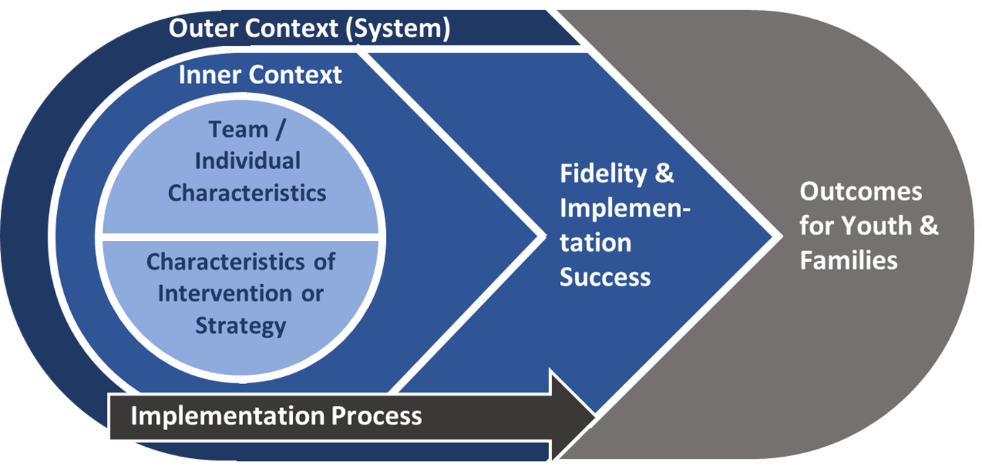
Implementation science models can help us assess effectiveness, adoption, and implementation fidelity
We can also use such models to track barriers and facilitators to implementation

Slide 9
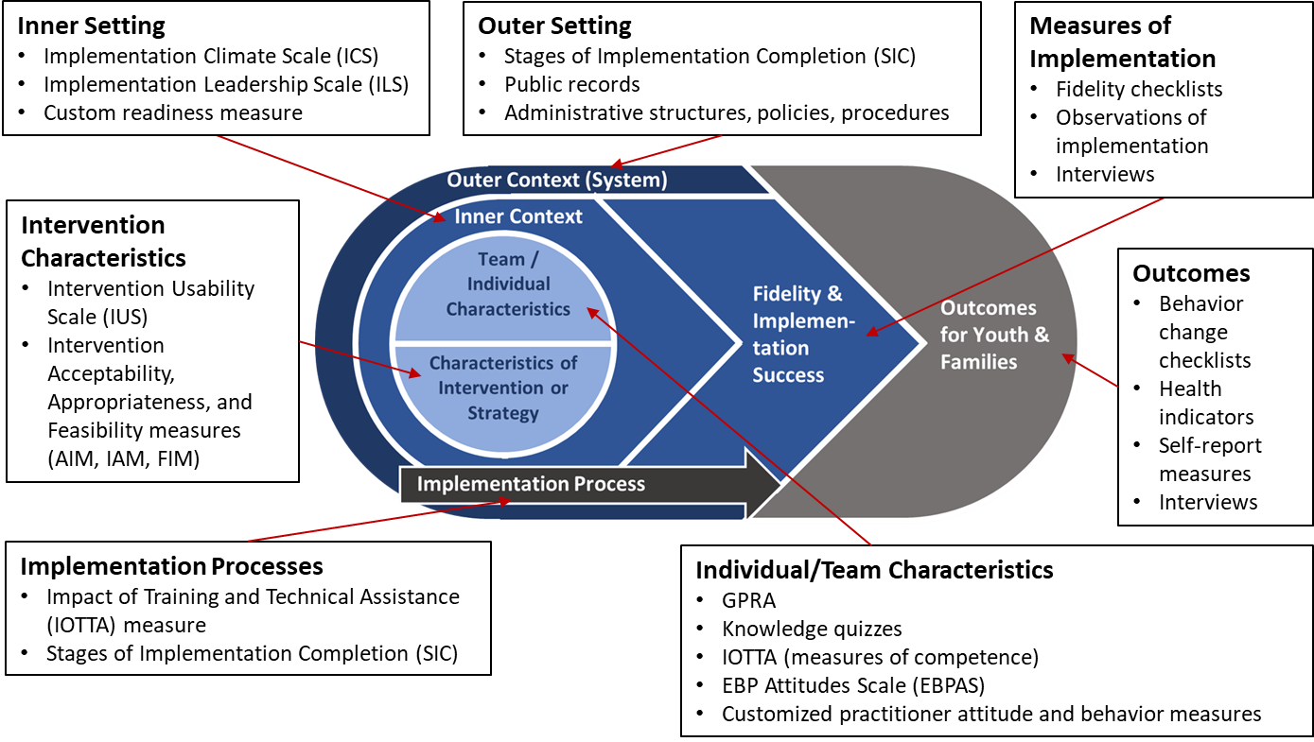

Slide 10
Follow-up assessments help us assess maintenance and sustainment over time

Slide 11
Intensive TA Project Example
Northeast & Caribbean MHTTC’s Motivational Interviewing project
 | Measure | Results
Reach (#/% of consumers) | Did not measure | N/A
Effectiveness of Intervention/Program/Services (w/consumers) | GPRA evaluations for the initial trainings and learning collaboratives for Administrators, Direct Service Staff, and Supervisors. | • Administrators evaluations: 100% would recommend to a colleague; 100% agree they will use information gained in their current practice. • Direct Service Providers: 100% would recommend to a colleague; 90% strongly agree or agree that they will use information gained in their current practice. • Supervisors—100% would recommend to a colleague; 100% strongly agree or agree that they expect this to benefit their professional practice or development.

Slide 12
 | Measure | Results
Adoption (#/% of providers) | Qualtrics Survey Evaluations (developed by NE&C MHTTC) from participants of the entire MI TA initiative, including open ended questions. | 100% of respondents found the MI trainings extremely or somewhat helpful. “Provided us with useful information, provided a safe place for each of us to share real information and allowed us to practice in the group to ensure the information was understood.”
Implementation Fidelity/ Adherence/Quality | Focus Groups for Admins and Staff | “Having a common framework has been very helpful. We have people from different backgrounds and so the common framework has been helpful. Conversations are more coherent.”
Maintenance & Sustainment | Assess changes to organization and sustained implementation of MI (evaluation developed by NE&C MHTTC) | No data at this time

Slide 13
Reflection - Breakout Rooms
RE-AIM Dimensions:
Reach, Effectiveness, Adoption, Implementation, Maintenance
1) What’s an ITA/TA project example where you were able to measure one or more of the RE-AIM dimensions? How did you achieve it?
2) Is there a particular dimension you’ve desired to measure but was difficult to achieve? Has anyone in the group dealt with this and would share what you learned?

Slide 14
Pathway to Using D&I Science in our Work
Implementation Project Template
Developed, piloted, and refined by the MHTTC D&I Working Group, with feedback from the ATTCs and PTTCs
Tool to assist in planning and tracking the progress of intensive TA projects that have the goal of implementing an intervention/program/practice (versus those focused on awareness raising or training only).
Based on the key D&I frameworks
Web-based version accessed through the MHTTC Intranet

Slide 15
Using the Project Template to Plan and Track Intensive TA Projects
Classroom WISE TA Opportunity
Fall 2021

Slide 16
Implementation Project Template on the MHTTC Intranet
www.mhttcintranet.org
Any TTC staff person can get a log-in
Contact Ricky Canelo, rcanelo@stanford.edu

Slide 17
Practicing our Learnings
Think about an intensive TTA project that you/your team has worked on or are planning to work on.
Take 5 minutes to answer the following questions:
What is the need/rationale for this project? Why was the decision made to do this project?
Who is the target audience (including organizations, individuals, cultural considerations)?
How did/will you recruit/engage the audience?
What system, individual, or organizational factors will aid implementation? What may be barriers?
List several implementation strategies that will/were used in this intensive project.

Slide 18
Reflection - Breakout Rooms
What was your experience completing these template questions? Were some questions more challenging? Easier?
How would you see using this tool to plan for an intensive TTA project?
How would you see using TTA summaries provided by other MHTTCs?

Slide 19
Next Steps to Use D&I Science in Our Work

Slide 20
Using D&I Science in Our Work
Use the implementation template to plan and monitor technical assistance projects
Understand the context before planning implementation strategies/technical assistance
Assess barriers/facilitators and readiness
Tailor implementation strategies/technical assistance based on need
Consider how to evaluate the impact of your work

Slide 21
How can we help you use D&I in your work?
Plans in progress:
Recordings & slides from these sessions
D&I handbook and implementation template manual
Implementation template office hours
Poll Everywhere question

Slide 22
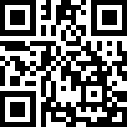
THANK YOU!
Please complete our short, 5-minute evaluation using the link or QR code below: https://ttc-gpra.org/P?s=497426

Slide 23
Bibliography
Aarons, G. A., Hurlburt, M., & Horwitz, S. M. (2011). Advancing a conceptual model of evidence-based practice implementation in public service sectors. Administration Policy and Mental Health, 38, 4-23. https://doi.org/10.1007/s10488-010-0327-7
Addiction Technology Transfer Center (ATTC) Network Technology Transfer Workgroup. (2011). Research to practice in addition treatment: Key terms and a field-driven model of technology transfer. Journal of Substance Abuse Treatment, 41(2), 169-178. https://doi.org/10.1016/j.jsat.2011.02.006
Bertram, R., Blase, K., Shern, D., Shea, P., & Fixsen, D. (2011). Policy research brief: Implementation opportunities and challenges for prevention and promotion initiatives. National Association of State Mental Health Program Directors (NASMHPD). https://www.nasmhpd.org/sites/default/files/Policy%20Research%20Brief%20on%20Implementation%20Opportunities%20and%20B_1.pdf
Budhwani, H., Hearld, K. R., & Chavez-Yenter, D. (2015). Depression in racial and ethnic minorities: The impact of nativity and discrimination. Journal of Racial and Ethnic Health Disparities, 2(1), 34-42. https://doi.org/10.1007/s40615-014-0045-z
Cabassa, L. J., & Stefancic, A. (2019). Context before implementation: a qualitative study of decision makers' views of a peer-led healthy lifestyle intervention for people with serious mental illness in supportive housing. Translational Behavioral Medicine, 9(2), 217–226. https://doi.org/10.1093/tbm/iby034
Center for Behavioral Health Statistics and Quality, Substance Abuse and Mental Health Services Administration. (2016). 2015 National Survey on Drug Use and Health: Detailed tables. https://www.samhsa.gov/data/sites/default/files/NSDUH-DetTabs-2015/NSDUH-DetTabs-2015/NSDUH-DetTabs-2015.pdf
Center for Behavioral Health Statistics and Quality, Substance Abuse and Mental Health Services Administration. (2020, June). Results from the 2019 National Survey on Drug Use and Health: Graphics from the key findings report. https://www.samhsa.gov/data/report/2019-nsduh-annual-national-report
Cross-Technology Transfer Center (TTC) Workgroup on Virtual Learning. (2021). Virtual reality for behavioral health workforce development in the era of COVID-19. Journal of Substance Abuse Treatment, 121, 108157. https://doi.org/10.1016/j.jsat.2020.108157
Curran, G. M. (2020). Implementation science made too simple: a teaching tool. Implementation Science Communications, 1, 27. https://doi.org/10.1186/s43058-020-00001-z
Damschroder, L. J., Aron, D. C., Keith, R. E., Kirsh, S. R., Alexander, J. A., & Lowery, J. C. (2009). Fostering implementation of health services research findings into practice: a consolidated framework for advancing implementation science. Implementation Science, 4, 50. https://doi.org/10.1186/1748-5908-4-50
Finnerty, M., Austin, E., Chen, Q., Layman, D., Kealey, E., Ng-Mak, D., Rajagopalan, K., & Hoagwood, K. (2019). Implementation and use of a client-facing web-based shared decision-making system (MyCHOIS-CommonGround) in two specialty mental health clinics. Community Mental Health Journal, 55(4), 641–650. https://doi.org/10.1007/s10597-018-0341-x
Fixsen, D., Naoom, S., Blase, K., Friedman, R., Wallace, F. (2005). Implementation research: A synthesis of the literature. National Implementation Research Network. https://nirn.fpg.unc.edu/sites/nirn.fpg.unc.edu/files/resources/NIRN-MonographFull-01-2005.pdf
Glasgow, R. E., Vogt, T. M., & Boles, S. M. (1999). Evaluating the public health impact of health promotion interventions: the RE-AIM framework. American Journal of Public Health, 89(9), 1322–1327. https://doi.org/10.2105/ajph.89.9.1322
Grimshaw, J. M., Shirran, L., Thomas, R., Mowatt, G., Fraser, C., Bero, L., Grilli, R., Harvey, E., Oxman, A., & O’Brien, M. A. (2001). Changing provider behavior: An overview of systematic reviews of interventions. Medical Care, 39(8 Suppl 2), II2-II45. http://www.jstor.org/stable/3767642
Grimshaw, J. M., Thomas, R. E., MacLennan, G., Fraser, C., Ramsay, C. R., Vale, L., Whitty, P., Eccles, M. P., Matowe, L., Shirran, L., Wensing, M., Dijkstra, R., & Donaldson, C. (2004). Effectiveness and efficiency of guideline dissemination and implementation strategies. Health Technology Assessment, 8(6), iii–72. https://doi.org/10.3310/hta8060
Henggeler, S. W., Schoenwald, S. K., Liao, J. G., Letourneau, E. J., & Edwards, D. L. (2002). Transporting efficacious treatments to field settings: the link between supervisory practices and therapist fidelity in MST programs. Journal of Clinical Child and Adolescent Psychology, 31(2), 155–167. https://doi.org/10.1207/S15374424JCCP3102_02
Interdepartmental Serious Mental Illness Coordinating Committee. (2017). The way forward: Federal action for a system that works for all people living with SMI and SED and their families and caregivers. https://www.samhsa.gov/sites/default/files/programs_campaigns/ismicc_2017_report_to_congress.pdf
Joyce, B., & Showers, B. (2002). Designing training and peer coaching: Our need for learning. In B. Joyce & B. Showers (Eds.), Student achievement through staff development (pp. 69–94). ASCD.

Slide 24
Bibliography
Kilbourne, A. M., Almirall, D., Goodrich, D. E., Lai, Z., Abraham, K. M., Nord, K. M., & Bowersox, N. W. (2014). Enhancing outreach for persons with serious mental illness: 12-month results from a cluster randomized trial of an adaptive implementation strategy. Implementation Science, 9, 163. https://doi.org/10.1186/s13012-014-0163-3
Kilbourne, A. M., Goodrich, D. E., Lai, Z., Almirall, D., Nord, K. M., Bowersox, N. W., & Abraham, K. M. (2015). Reengaging veterans with serious mental illness into care: preliminary results from a national randomized trial. Psychiatric Services, 66(1), 90–93. https://doi.org/10.1176/appi.ps.201300497
Kirchner, J. E., Woodward, E. N., Smith, J. L., Curran, G. M., Kilbourne, A. M., Owen, R. R., & Bauer, M. S. (2016). Implementation science supports core clinical competencies: An overview and clinical example. The Primary Care Companion for CNS Disorders, 18(6), e1-e7. https://doi.org/10.4088/PCC.16m02004
Koczwara, B., Stover, A. M., Davies, L., Davis, M. M., Fleisher, L., Ramanadhan, S., Schroeck, F. R., Zullig, L. L., Chambers, D. A., & Proctor, E. (2018). Harnessing the synergy between improvement science and implementation science in cancer: A call to action. Journal of Oncology Practice, 14(6), 335-340. https://doi.org/10.1200/JOP.17.00083
Mascayano, F., Nossel, I., Bello, I., Smith, T., Ngo, H., Piscitelli, S., Malinovsky, I., Susser, E., & Dixon, L. (2019). Understanding the implementation of coordinated specialty care for early psychosis in New York state: A guide using the RE-AIM framework. Early Intervention in Psychiatry, 13(3), 715–719. https://doi.org/10.1111/eip.12782
Maura, J., & Weisman de Mamani, A. (2017). Mental health disparities, treatment engagement, and attrition among racial/ethnic minorities with severe mental illness: A review. Journal of Clinical Psychology in Medical Settings, 24(3-4), 187–210. https://doi.org/10.1007/s10880-017-9510-2
McHugo, G. J., Drake, R. E., Teague, G. B., & Xie, H. (1999). Fidelity to assertive community treatment and client outcomes in the New Hampshire dual disorders study. Psychiatric Services, 50(6), 818–824. https://doi.org/10.1176/ps.50.6.818
Nilsen, P. (2015). Making sense of implementation theories, models and frameworks. Implementation Science, 10, 53. https://doi.org/10.1186/s13012-015-0242-0
Powell, B. J., McMillen, J. C., Proctor, E. K., Carpenter, C. R., Griffey, R. T., Bunger, A. C., Glass, J. E., & York, J. L. (2012). A compilation of strategies for implementing clinical innovations in health and mental health. Medical Care Research and Review, 69(2), 123–57. https://doi.org/10.1177/1077558711430690
Proctor, E., Hooley, C., Morse, A., McCrary, S., Kim, H., & Kohl, P. L. (2019). Intermediary/purveyor organizations for evidence-based interventions in the US child mental health: Characteristics and implementation strategies. Implementation Science, 14, 3. https://doi.org/10.1186/s13012-018-0845-3
Rabin, B. A., & Brownson, R. C. (2018). Terminology for dissemination and implementation research. In R. C. Brownson, G. A. Colditz, & E. K. Proctor (Eds.) Dissemination and implementation research in health: Translating science to practice (2nd ed.). Oxford University Press.
Rojas Smith, L., Ashok, M., Morss Dy, S., Wines, R. C., & Teixeira-Poit, S. (2014). Contextual frameworks for research on the implementation of complex system interventions. Agency for Healthcare Research and Quality (US).
Smith, S. N., Almirall, D., Prenovost, K., Goodrich, D. E., Abraham, K. M., Liebrecht, C., & Kilbourne, A. M. (2018). Organizational culture and climate as moderators of enhanced outreach for persons with serious mental illness: results from a cluster-randomized trial of adaptive implementation strategies. Implementation Science, 13, 93. https://doi.org/10.1186/s13012-018-0787-9
Squires, J. E., Sullivan, K., Eccles, M. P., Worswick, J., & Grimshaw, J. M. (2014). Are multifaceted interventions more effective than single-component interventions in changing health-care professionals' behaviours? An overview of systematic reviews. Implementation Science, 9, 152. https://doi.org/10.1186/s13012-014-0152-6
Stilen, P. (2013). Personal communication.
Waltz, T. J., Powell, B. J., Fernández, M. E., Abadie, B., & Damschroder, L. J. (2019). Choosing implementation strategies to address contextual barriers: Diversity in recommendations and future directions. Implementation Science, 14, 42. https://doi.org/10.1186/s13012-019-0892-4
Young, A. S., Cohen, A. N., Chang, E. T., Flynn, A., Hamilton, A. B., Oberman, R., & Vinzon, M. (2018). A clustered controlled trial of the implementation and effectiveness of a medical home to improve health care of people with serious mental illness: Study protocol. BMC Health Services Research, 18(1), 428. https://doi.org/10.1186/s12913-018-3237-0

